Slide 1
Zoom help slides for the Zoom host
A UKCEH branded version is available from Dr Ingo Schüder via UKCEHtraining@ceh.ac.uk
Version: 3 March 2021
© UK Centre for Ecology & Hydrology 2021
Licence: CC BY
You distribute, remix, adapt, and build upon this file, even commercially, as long as you credit the UK Centre for Ecology & Hydrology for the original creation.

Slide 2
These slides help the person fulfilling the Zoom Host role to
Welcome learners
Trouble shoot audio & video issues
Introduce the learners to the key Zoom functions for interactive learning/ participation
Introduce breakout rooms and screen sharing/ collaboration
Show them at the start of your meeting via Screen Share

Slide 3
TROUBLE-SHOOTING SLIDES

Slide 4
Welcome to [training title]
Consider putting your head & shoulder image here
[Host name & job title]
Our priority between now and [TIME] is to ensure your sound and video works
i.e. we can see and hear you (and vice versa)
You have joined with your mike muted, so we cannot hear you!
You have joined with your camera turned off to save internet bandwidth (see next slide) REVIEW
If you experience problems, and nothing else works, email [name & email]

Slide 5
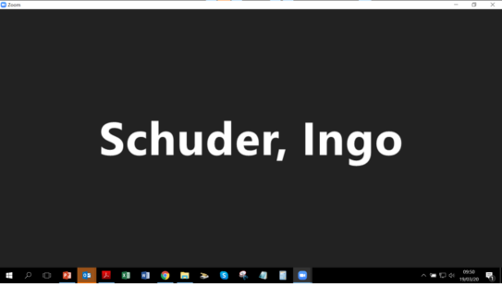
You join with Video off- you and others will see this for your screen: (remove this slide if setting is ‘join with video on’)
If sound & video work for you (both ways), feel free to get a cuppa - please be back at [TIME]
Joe Blogs
[your name]

Slide 6
Hover over the bottom of your Zoom screen to see the Zoom menu bar (Mike/Video/Share/Chat/Reactions)
Maximise your Zoom window to see all Zoom menu options
(or click the three ∘∘∘ for “More options”)
Joe Blogs
[your name]
Mute/unmute
Video on/off
Share Screen
Chat
Reactions

Slide 7
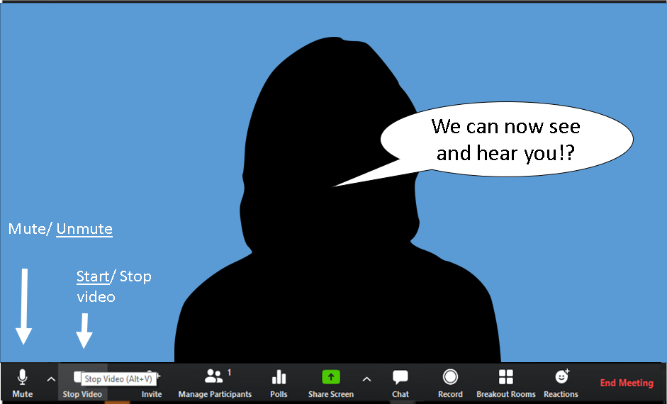
If sound & video work for you (both ways), feel free to get a cuppa - please be back 9:40
Unmute yourself when prompted and replace your black screen with your video feed (“Start Video”)

Slide 8
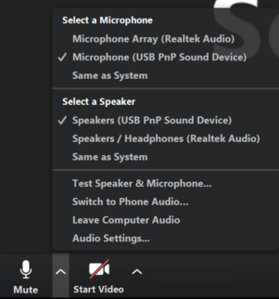
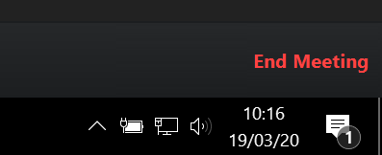
If you cannot hear the presenter, try out the Zoom drop-down menu next to the microphone symbol
or adapt your sound volume (loudspeaker symbol in very bottom right corner of your desktop view)

Slide 9
If sound still does not work…
Chat to the host [HOST name as displayed in Zoom]
Or email: [email address]
Chat

Slide 10
If sound and video works (both ways), please join us again at [TIME]! We will then introduce some of the interactive functions of Zoom.

Slide 11
INTRODUCING BASIC ZOOM FUNCTIONS SLIDES

Slide 12
Welcome back!
Consider putting your head & shoulder image here
Between now and [TIME], I will introduce you to some of the Zoom functions, so you can use it effectively and for the interaction.

Slide 13
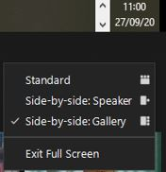
Zoom views during screen share
SPEAKER VIEW
Screen share is Large - Presenter has small image
Shared screen (PPT or WWW)
Hover over the top right corner to see the Gallery view/ Speaker view Symbol
GALLERY VIEW
Every screen is the same size
FOR DISCUSSIONS
Shared screen (PPT or WWW)
In Screen Share Gallery View you can drag and drop the separation between the shared screen & learners’ video screen to make the shared screen smaller and see more learners

Slide 14
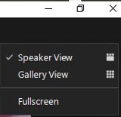
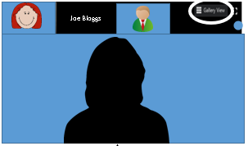
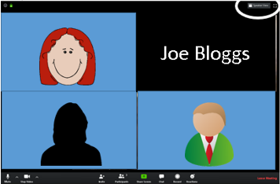
Zoom views while no screen share
SPEAKER VIEW
Presenter is large, all others have small images on top of presenter image
Hover over the top right corner to see the Gallery view/ Speaker view Symbol
GALLERY VIEW
Every screen is the same size
FOR DISCUSSIONS

Slide 15
Using Reactions
Show your appreciation for the speaker
Indicate you understand the instructions for the next exercise
(or just for fun)
A large yellow symbol will appear here for 30 seconds
Reactions

Slide 16
Using Participants/ raise hand
Another way to get the attention of the hosts
Participants

Slide 17
Using Chat
Ask presenter a question
Share info with all participants
(communicate with people who have audio problems)
Chat

Slide 18
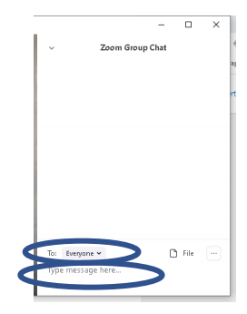
We will use chat in this Zoom meeting
In main Zoom menu, click on ‘Chat’ (see previous slide)
This side-window will open →
You can chat to everyone (default), to another participant or to the host [Host name] or co-host [co-host name]

Slide 19
Unmuting yourself
A quick and easy way to unmute yourself is to use the space bar – just hold the spacebar down while you are speaking and when you release it, you will return to muted!

Slide 20
More Zoom functions later!
Let’s start the training!
We will start the recording NOW!

Slide 21
BREAKOUT ROOM HELP SLIDES suggest to use these just before you use BOR, i.e. not at the start of the day

Slide 22
Interactive group Exercises – Breakout room
In a moment, we will send you to a virtual breakout room.
You will work in groups of [NUMBER] people
Before you go, a few more functions of Zoom!

Slide 23
Help in breakout room
You cannot use chat to share a message with the host or co-host.
When you Chat in breakout room, only the people in your room can see the chat.
Raise your Hand to get the host’s attention.
There is a ‘Ask for Help’ function in each breakout room. The host will respond ASAP.
The following people will facilitate your breakout room exercise:
[FACILITATOR NAMES]
[GROUP/ROOM NAMES]

Slide 24
Facilitators in Breakout rooms
Breakout room 1-5: [facilitator name]
Breakout room 6-10: [facilitator name]

Slide 25
Group exercise chose this slide or the next
Work independently as an individual to start with
Peer learning:
Before you ask the host for help, ask your peer learner!
You can “share screens” & “remote control” with each other and show what your problem is / what you did to overcome the problem.
b) Work as a team with the other person in your breakout room right from the start
One person takes the lead and shares their screen
You use chat and verbal communication to jointly work through the exercise
You can use the “remote control” function, so that both of you work on the shared screen
When you are both stuck, “ask for help” and “share screen” to show the facilitator what you have done so far

Slide 26
Collaborative work during Screen Share
One person in breakout room takes the lead and shares the [document]
Two ways to work
The other breakout room members contribute verbally or via chat.
The lead person enters their contribution into the [document]
2. Other learners get remote control to the Shared Screen and enter their contributions directly

Slide 27
Sharing your screen
Share Screen

Slide 28
Selecting the correct screen for sharing
OR
The others in your group can now see your screen or your document

Slide 29
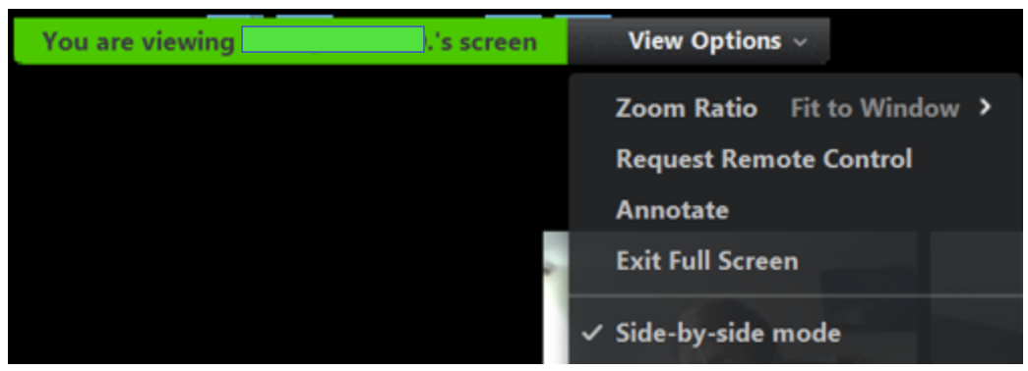
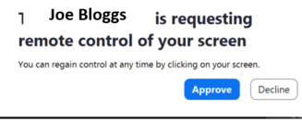
Remote control in screen share
Screen sharer: Sharing menu bar/ Remote Control/ Give Mouse/Keyboard control to/ (select a learner from list)
loggs
Screen sharer can also tick “Auto Accept all requests”
loggs
Other learner: Sharing menu bar/ Remote Control/ Request remote Control
If the Screen sharer has not ticked: Auto accept, she/ he will have to approve your screen share request

Slide 30
Stop sharing

Slide 31
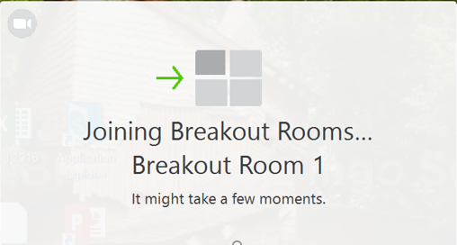
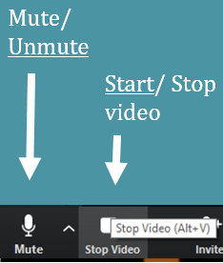
In a moment, please accept invitation to join a breakout room
You will be placed in the breakout room automatically – HOST please see latest BOR guidance
You will very briefly see this …
Once in breakout room, please Start Video and Unmute yourself!

Slide 32
Coming back to the main meeting
You can come back to the main meeting at any time (Click on the blue ‘Leave Room’ button).
We will broadcast a message to give you a [TIME] min warning that the group exercise is ending.
You will get a [TIME default: 60 second] warning that the breakout room session is ending.
You will then automatically re-join the main meeting.
Never click on the red ‘Leave Meeting’ button!

Slide 33
Insert any further slides
e.g.
Advertising future courses
Prompt to go to online feedback form

