Slide 1


EICAT
Environmental Impact Classification for Alien Taxa

Slide 2
What is EICAT?
A simple, objective and transparent method to classify alien taxa according to the magnitude and type of their detrimental environmental impact in recipient areas
Notes:
…according to the magnitude and type of their environmental impacts

Slide 3
EICAT can…
…help identify taxa with different levels of impact, and flag those with high impacts
…facilitate comparisons of impact among regions and taxa
…facilitate predictions of impacts
…aid in prioritisation of management actions
Notes:
…and flag those with high impacts

Slide 4
EICAT can…
…help identify taxa with different levels of impact, and flag those with high impacts
…facilitate comparisons of impact among regions and taxa
…facilitate predictions of impacts
…aid in prioritisation of management actions
Notes:
…and flag those with high impacts

Slide 5

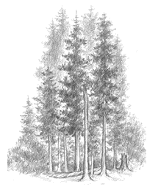
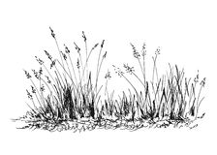
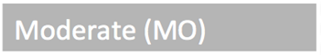

Habitat: Robinia pseudoacacia
“A. ranunculoides was negatively correlated with Robinia density….”
“Many of these species became [locally] extinct from the vegetation during the Robinia invasion…”
Branquart et al. (2017) Introduced tree species in European forests

Slide 6
EICAT can…
…help identify taxa with different levels of impact, and flag those with high impacts
…facilitate comparisons of impact among regions and taxa
…facilitate predictions of impacts
…aid in prioritisation of management actions
Notes:
…and flag those with high impacts

Slide 7
Impact vs. traits
Expected
Environmental impact
Environmental impact
Fecundity [log]
Native range size [latitudinal degrees]
Kesner & Kumschick (2018) Ecol Evol

Slide 8
Impact vs. traits
Observed
Environmental impact
Environmental impact
Fecundity [log]
Native range size [latitudinal degrees]
Kesner & Kumschick (2018) Ecol Evol

Slide 9
Traits and impact
Kumschick et al. (2013) Biol Invasions

Slide 10
EICAT can…
…help identify taxa with different levels of impact, and flag those with high impacts
…facilitate comparisons of impact among regions and taxa
…facilitate predictions of impacts
…aid in prioritisation of management actions
Notes:
…and flag those with high impacts

Slide 11
Why is it better than other schemes?
Clearly distinct impact levels
Includes all impact mechanisms
Applicable across taxonomic groups
Adopted by IUCN and embedded in global conservation efforts

Slide 12
Why is it better than other schemes?
Clearly distinct impact levels
Includes all impact mechanisms
Applicable across taxonomic groups
Adopted by IUCN and embedded in global conservation efforts

Slide 13
Impact categories
Blackburn et al. (2014) Plos Biol; Hawkins et al. (2015) Div Dist
Notes:
The basic purpose of EICAT is to classify alien taxa according to the magnitude of their impacts on the recipient biodiversity.
It aims to distinguish species with and without alien populations, and amongst the ones with alien populations, one category includes taxa with no data available on environmental impacts. The taxa with data are then separated into categories based on the magnitude of their impacts, with increasing impacts from Minimal Concern to Massive

Slide 14
Currency
Increasing magnitude
Increasing level of organisation in native community
Notes:
And this is what we came up with…
For environmental impacts, we measure effects on the levels of individuals, populations and communities. Thinking about this hard and long, we figured we could do the same for socio-economic impact, in a way it would cover human well-being. This is not only individual well-being, but the societies well-being, so more of a collective well-being.

Slide 15
Currency
individuals
Notes:
And this is what we came up with…
For environmental impacts, we measure effects on the levels of individuals, populations and communities. Thinking about this hard and long, we figured we could do the same for socio-economic impact, in a way it would cover human well-being. This is not only individual well-being, but the societies well-being, so more of a collective well-being.

Slide 16
Currency
populations
Notes:
And this is what we came up with…
For environmental impacts, we measure effects on the levels of individuals, populations and communities. Thinking about this hard and long, we figured we could do the same for socio-economic impact, in a way it would cover human well-being. This is not only individual well-being, but the societies well-being, so more of a collective well-being.

Slide 17

Currency
communities
Notes:
And this is what we came up with…
For environmental impacts, we measure effects on the levels of individuals, populations and communities. Thinking about this hard and long, we figured we could do the same for socio-economic impact, in a way it would cover human well-being. This is not only individual well-being, but the societies well-being, so more of a collective well-being.

Slide 18
Currency
= native species
communities
populations
individuals
Notes:
And this is what we came up with…
For environmental impacts, we measure effects on the levels of individuals, populations and communities. Thinking about this hard and long, we figured we could do the same for socio-economic impact, in a way it would cover human well-being. This is not only individual well-being, but the societies well-being, so more of a collective well-being.

Slide 19
Why is it better than other schemes?
Clearly distinct impact levels
Includes all impact mechanisms
Applicable across taxonomic groups
Adopted by IUCN and embedded in global conservation efforts

Slide 20
Impact criteria (mechanisms)
Competition
Predation
Hybridisation
Transmission of diseases
Parasitism
Poisoning/toxicity
Bio-fouling
Grazing/herbivory/browsing
Chemical, physical or structural impact on ecosystem
Interaction with other alien species
Notes:
Alien species can cause a large diversity of impacts, some of extremely severe nature. Examples…
So we could say we should just keep all alien species out, and eradicate all in order to get rid of their impacts and prevent them. However we all know that this is neither feasible nor desirable as many alien species have benefits. Most are actually introduced for their benefits in the first place. Therefore, prioritisation is key!

Slide 21
Competition
Massive
Major
Moderate
Minor
Minimal
 | Competition resulting in replacement or local extinction of one or several native species; changes in community composition are irreversible | Competition resulting in local or population extinction of at least one native species, leading to changes in community composition, but changes are reversible when the alien taxon is removed | Competition resulting in a decline of population size of at least one native species, but no changes in community composition | Competition affects fitness (e.g., growth, reproduction, defence, immunocompetence) of native individuals without decline of their populations | Negligible level of competition with native species; reduction of fitness of native individuals is not detectable

Slide 22
Why is it better than other schemes?
Clearly distinct impact levels
Includes all impact mechanisms
Applicable across taxonomic groups
Adopted by IUCN and embedded in global conservation efforts

Slide 23
Taxa assessed

Slide 24
Amphibians
242 published sources
Impact data for ~37% of species (39)
<- 3 species
<- 8 species
<- 7 species
<- 18 species
104 species ->
<- 3 species
<- 65 species
7511 species ->
Kumschick et al. (2017) Neobiota

Slide 25
Gastropods (SA)
34 species assessed
146 published sources
<- 4
26 ->
<- 8
<- 12
<- 2
34 ->
<- 8
Kesner & Kumschick (2018) Ecol Evol

Slide 26
Bamboos
135 species assessed
66 published sources
Impact data for 20 species
Native and alien
<- 8
20 ->
<- 8
<- 3
<- 1
135 ->
<- 115
Canavan et al. (2019) Plants People Planet

Slide 27
Why is it better than other schemes?
Clearly distinct impact levels
Includes all impact mechanisms
Applicable across taxonomic groups
Being adopted by IUCN and embedded in global conservation efforts

Slide 28

EICAT
The scheme
Blackburn et al. (2014) Plos Biol; Hawkins et al. (2015) Div Dist
Notes:
The basic purpose of EICAT is to classify alien taxa according to the magnitude of their impacts on the recipient biodiversity.
It aims to distinguish species with and without alien populations, and amongst the ones with alien populations, one category includes taxa with no data available on environmental impacts. The taxa with data are then separated into categories based on the magnitude of their impacts, with increasing impacts from Minimal Concern to Massive

Slide 29

EICAT
The scheme
Blackburn et al. (2014) Plos Biol; Hawkins et al. (2015) Div Dist

Slide 30
Scope of EICAT assessment
Notes:
What is the scope of the assessment per species?

Slide 31

Taxonomic scale
Species
Sub-species
Variety
Taxonomic level needs to be specified

Slide 32

Geographic scale of assessments
Global
National
Regional
Habitat specific
Assessment scale to be specified, as well as information used

Slide 33
Global: Birds
Data from global alien range included
➔ 5
➔ 4
➔ 35
➔ 62
➔ 40
<- 1
121 ➔
415 ➔
➔ 294
10424 ➔
➔ 10009
Evans et al. (2016) Div Distr

Slide 34
Habitat: Robinia pseudoacacia
“A. ranunculoides was negatively correlated with Robinia density….” Staska et al. (2014)
“Many of these species became [locally] extinct from the vegetation during the Robinia invasion…” Matus et al. (2003)
Branquart et al. (2017) Introduced tree species in European forests

Slide 35
Scope of individual impact study
Notes:
What is the scope of the assessment per species?

Slide 36
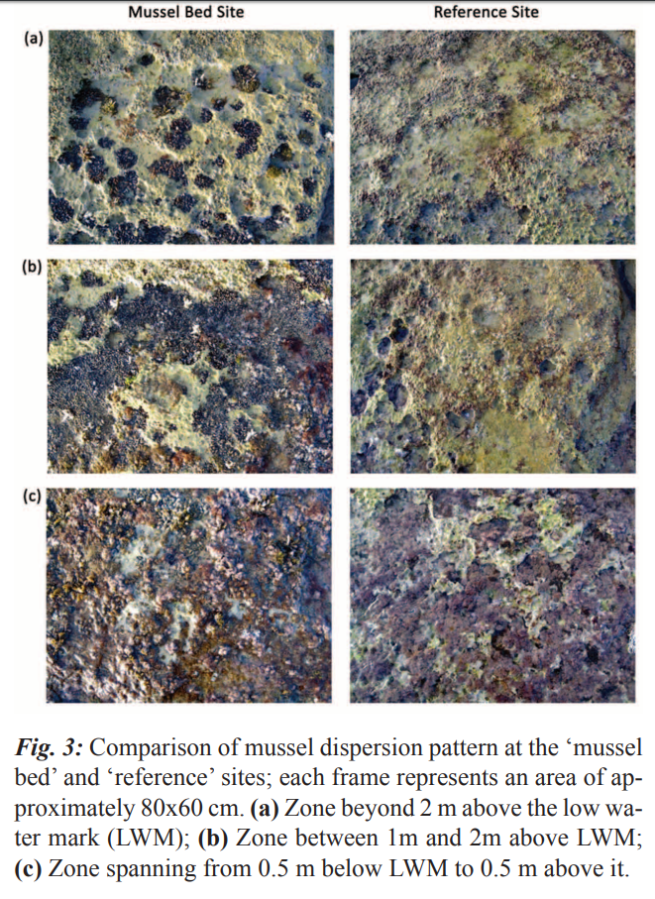
Spatial scale of impact studies
Bonnici et al. 2012 Mediterranean Marine Science

Slide 37
Spatial scale of impact studies
Confidence
Bonnici et al. 2012 Mediterranean Marine Science

Slide 38
Confidence
Confidence level | Examples
High | There is direct relevant evidence to support the assessment. Impact recorded at relevant spatial scale. Reliable/good quality data sources available. The interpretation of data/information is straightforward. Data/information are not controversial, contradictory.
Medium | There is some evidence to support the assessment. Extrapolation to relevant spatial scale considered reliable. The interpretation of the data is to some extent ambiguous or contradictory.
Low | No direct evidence, only inferred information available. Impacts recorded at spatial scale which may not be relevant to native community, and extrapolation considered unreliable. Evidence is poor and difficult to interpret, e.g. because it is strongly ambiguous. The information sources are considered to be of low quality or contain information that is unreliable.

Slide 39
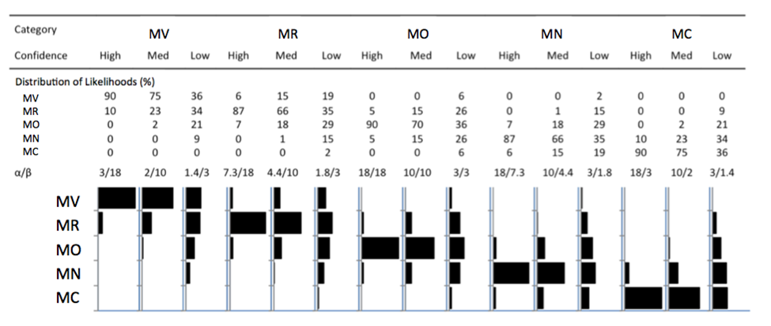
Probability distributions
Hawkins et al. (2015) Div Distr

Slide 40
Probability distributions
Hawkins et al. (2015) Div Distr

Slide 41
Take-home
Trialled and tested
Transparency of evidence
Highly flexible system
Useful for management
Advance theoretical understanding of impact

Slide 42

Thank you!
Questions?

