Slide 1
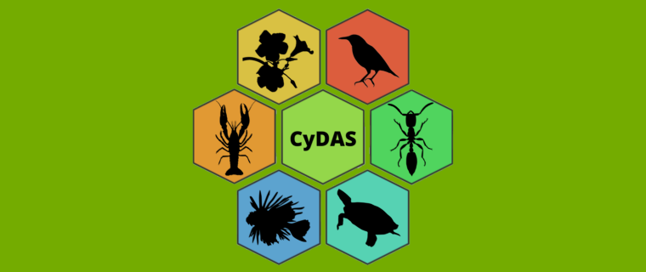
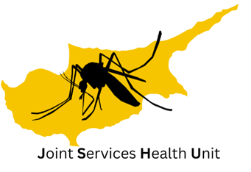
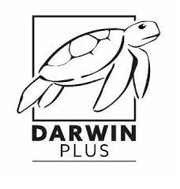
The Cyprus Database of Alien Species
Jakovos Demetriou
Biologist, MSc, PhD student
Darwin Fellow

Slide 2
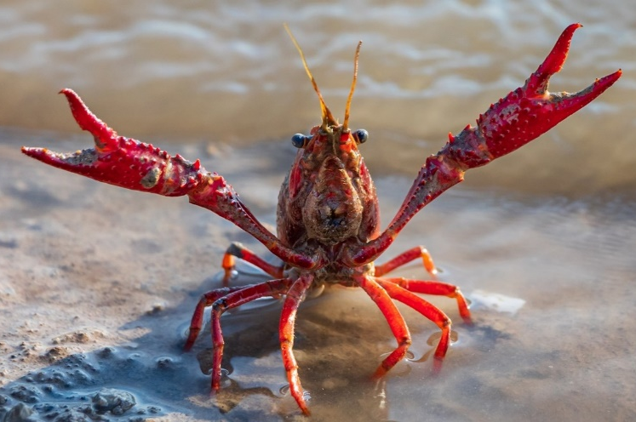
Biological Invasions
I WILL TAKE OVER THE WORLD!!!
More than 14,000 alien species in Europe.
Invasive species = main drivers of global biodiversity loss.
Adverse impacts on:
native biodiversity and ecosystem functions,
socioeconomic parameters,
constituents of human health and well-being.
Need for up-to-date alien species inventories and databases pooling available data, enhancing monitoring activities, providing impact assessments and guiding management prioritisation.

Slide 3
The story behind the platform
COST Action: Alien Challenge (COST TD1209) (2014 – 2018):
Compilation of the offline database: Cyprus Invasive Alien Species (CY.I.A.S) inventory.
Data pooled from published and unpublished material, online databases and projects i.e. DAISIE, EASIN, ELNAIS, and GBIF.
Information on: introduction pathways, origin, establishment success, first sighting collection date, reference(s).
At the time, CY.I.A.S contained 664 species (155 marine, 15 freshwater and 494 terrestrial species).
Researching the Invasive Species of Kýpros (RIS-Ký) project (2017 – 2021):
Darwin Plus projects (DPLUS056, 088), funded by the UK government.
CY.I.A.S was digitalised, supplemented and renamed as the Cyprus Database of Alien Species (CyDAS) (https://ris-ky.info/cydas).

Slide 4
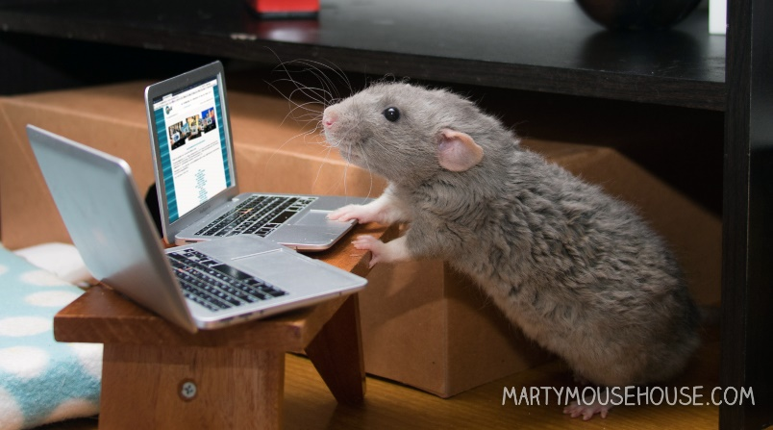
The story behind the platform
Darwin Plus 124:
Increasing local knowledge within the SBAs, Cyprus and beyond by providing accessible, user-friendly online resources through an online database alongside citizen-science to study native species-INNS interactions.
01/07/2021 to 30/06/2023.
Supervised by Dr Kelly Martinou and Prof Helen E Roy.
CyDAS → species profiles for 1228 alien species: Tracheophyta (571 species), Arthropoda (400 species), Chordata (104 species), Mollusca (66 species).
Updates on: first record year, references, occupied habitat etc.
Promotion of biodiversity recording and CS activities to monitor alien species.
New records of alien species for the island (particularly insects).

Slide 5
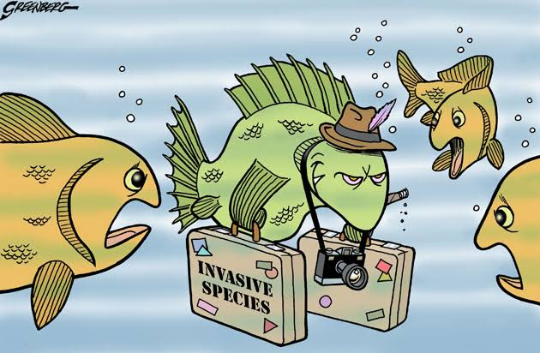
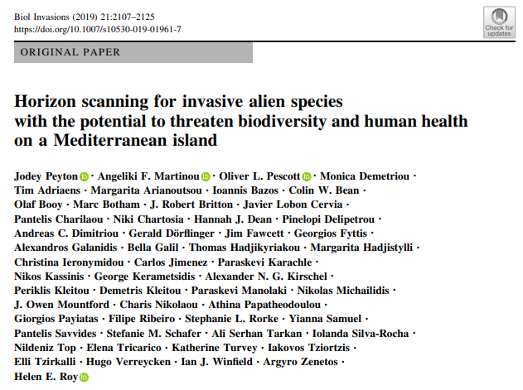
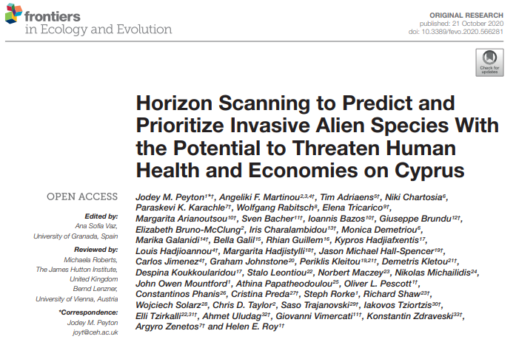
Horizon scanning exercises

Slide 6
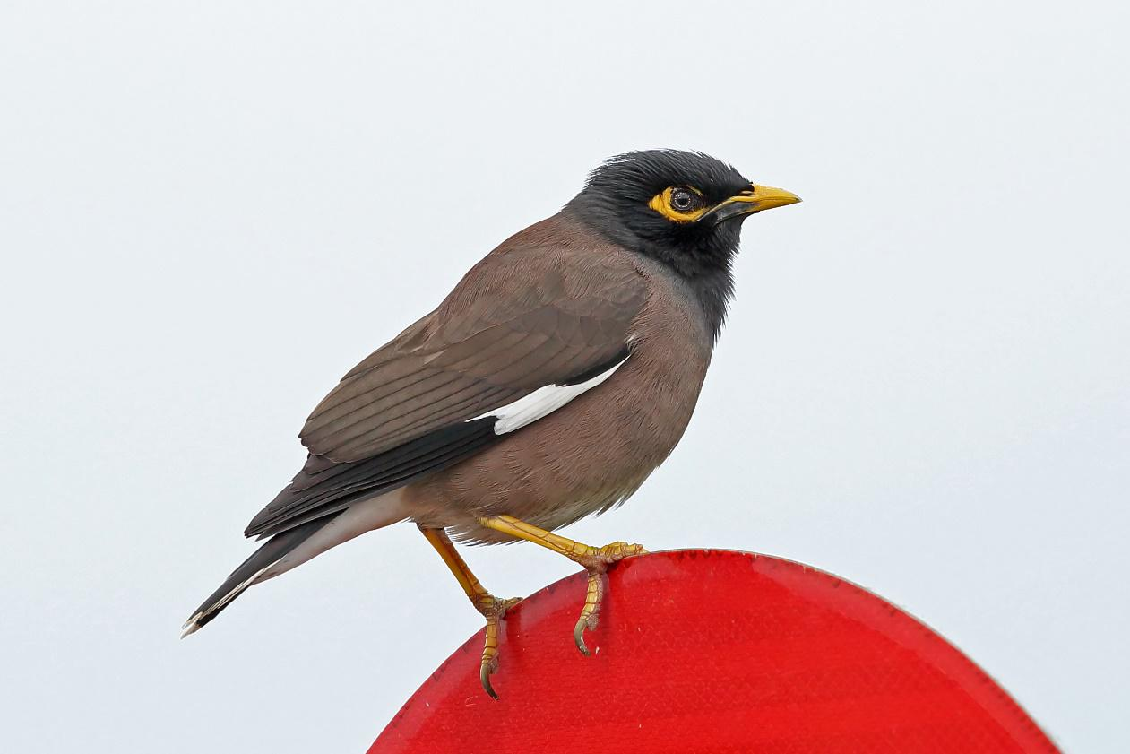
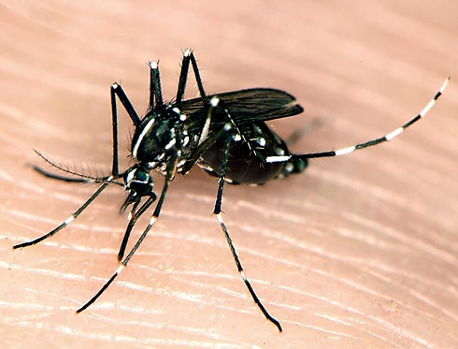
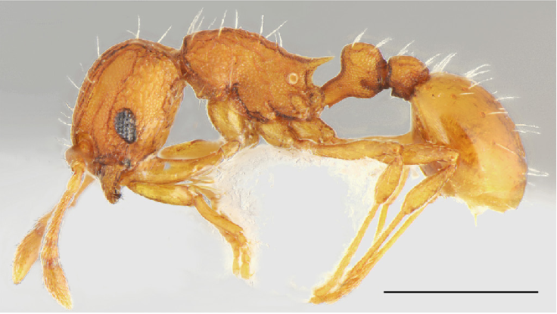
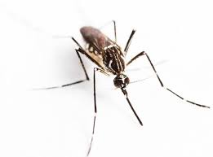
Horizon scanning exercises – new arrivals

Slide 7
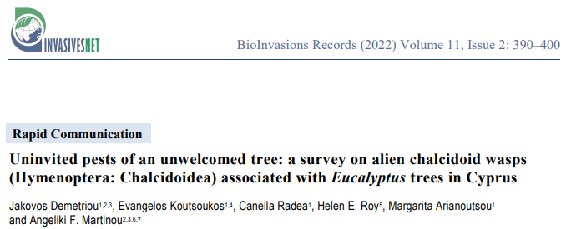
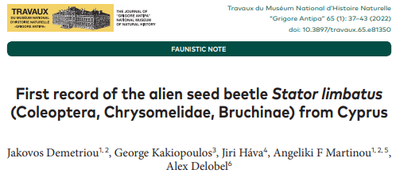
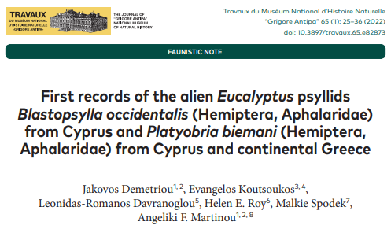
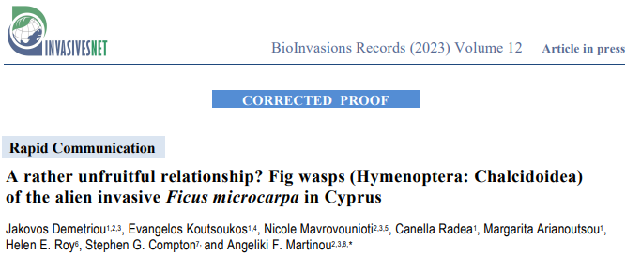

Slide 8
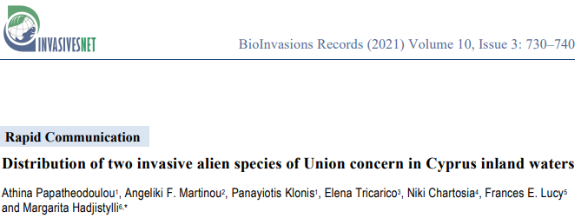
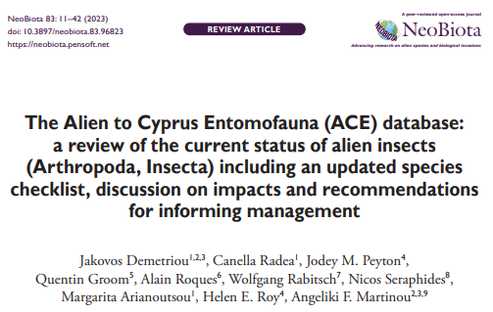
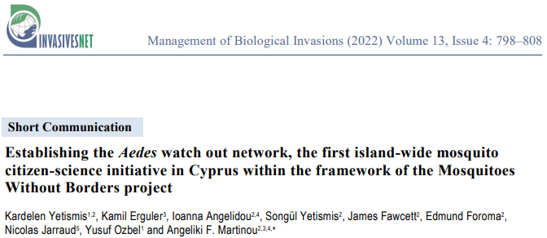

Slide 9
The platform

Slide 10
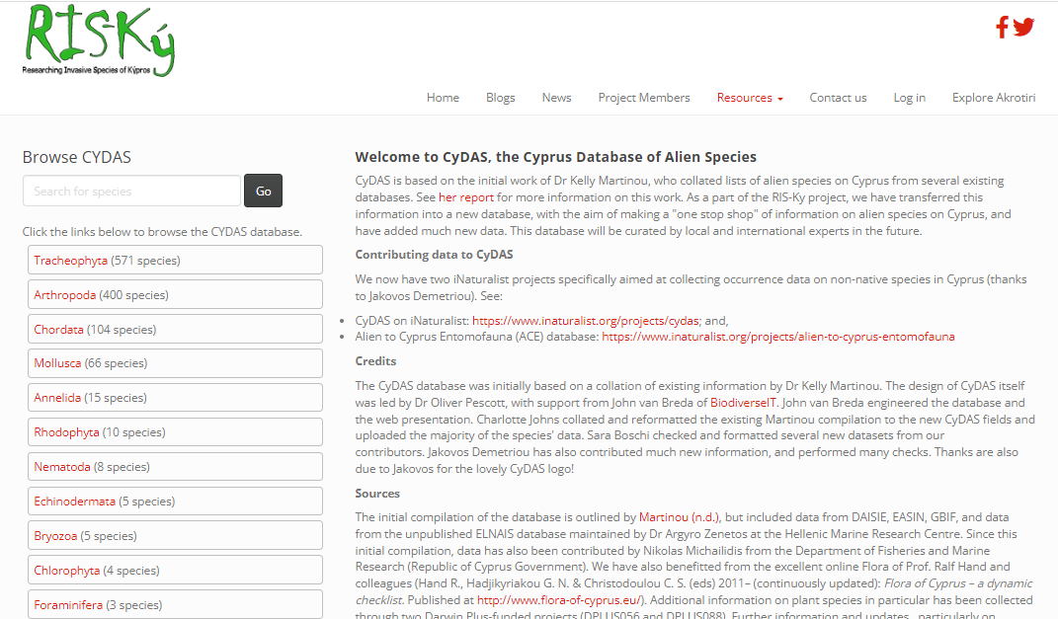

Slide 11
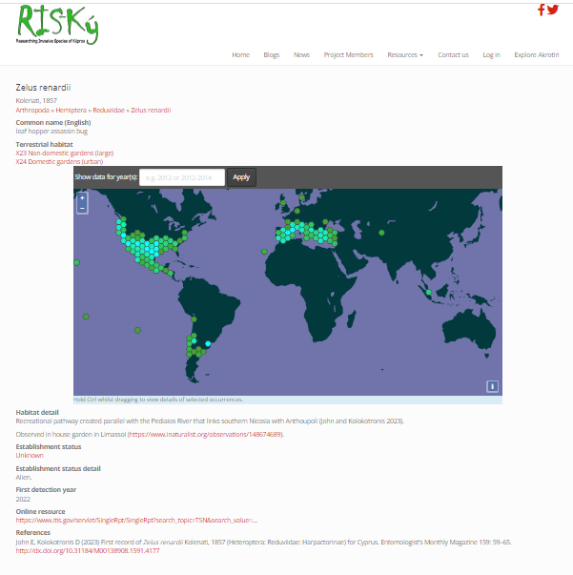
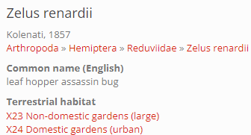

Slide 12
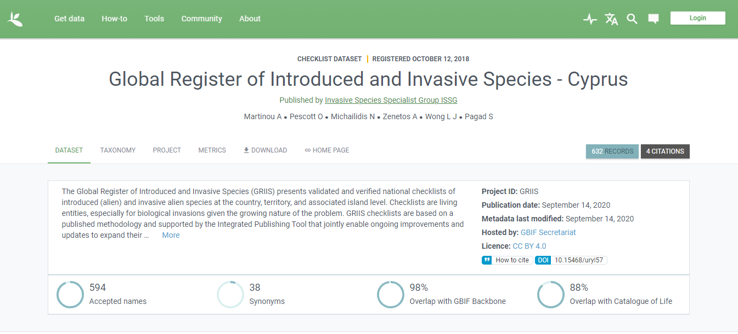

Slide 13
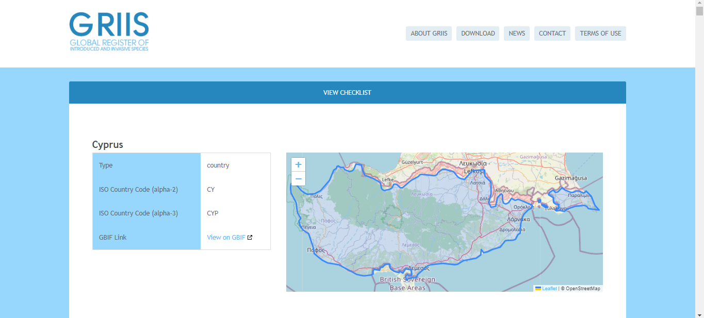

Slide 14
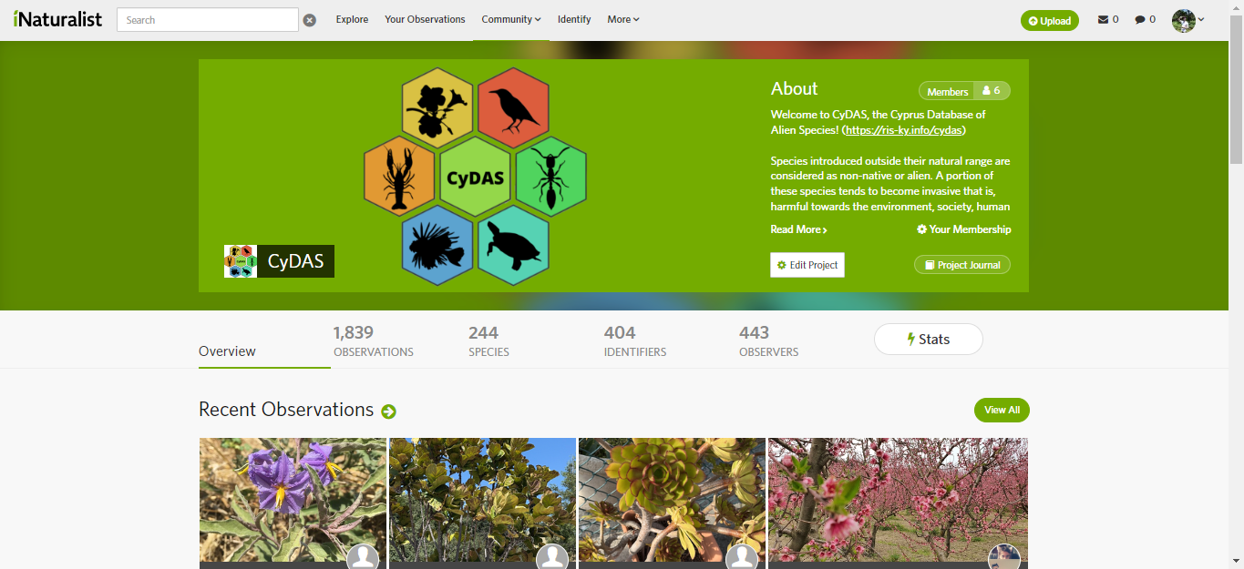

Slide 15
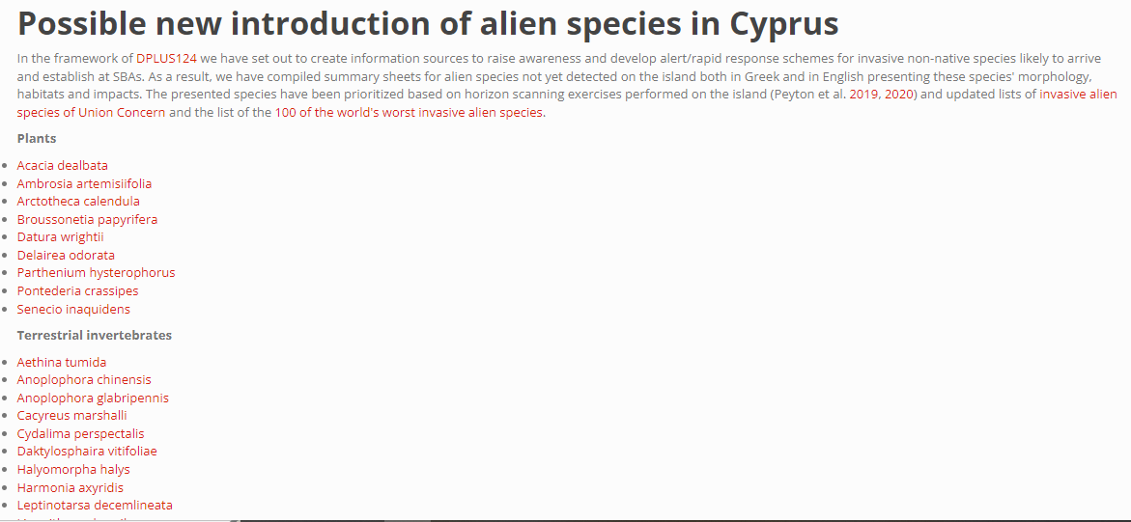
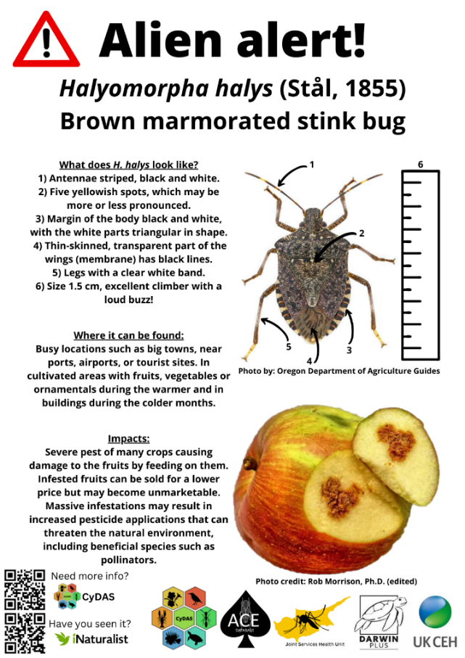
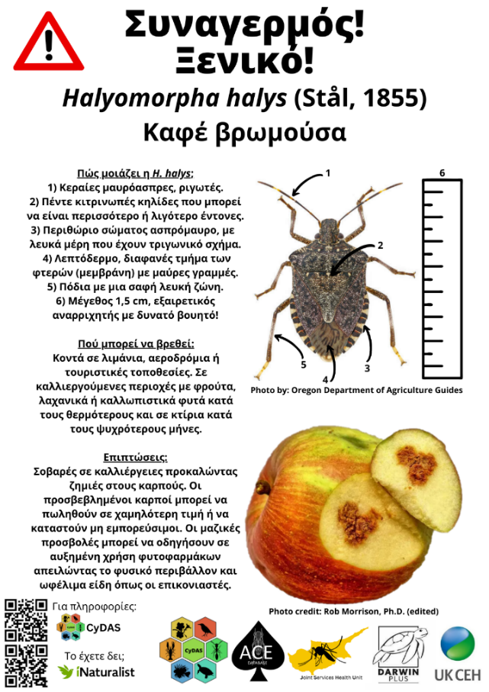
Further resources

Slide 16
Advantages and disadvantages of the CyDAS
Dynamic species inventory that allows quick editing of data and species.
iNaturalist project allows us to promote biodiversity recording and map the species distribution on the site (Researchgrade data are automatically uploaded to GBIF).
Data downloadable as .csv file (upon request).
Communication with GRIIS, EASIN and GBIF when updates are available.
Information source for both experts and non-experts.
Bugs (i.e. images size and appearance).
Species not present in GBIF or COL do not appear under taxonomic trees.
Interface based on taxonomy (not particularly friendly to non-taxonomists, although search tool is available).
Taxonomy of some species on GBIF is problematic.
Need for team of specialists for different organismic groups.

Slide 17
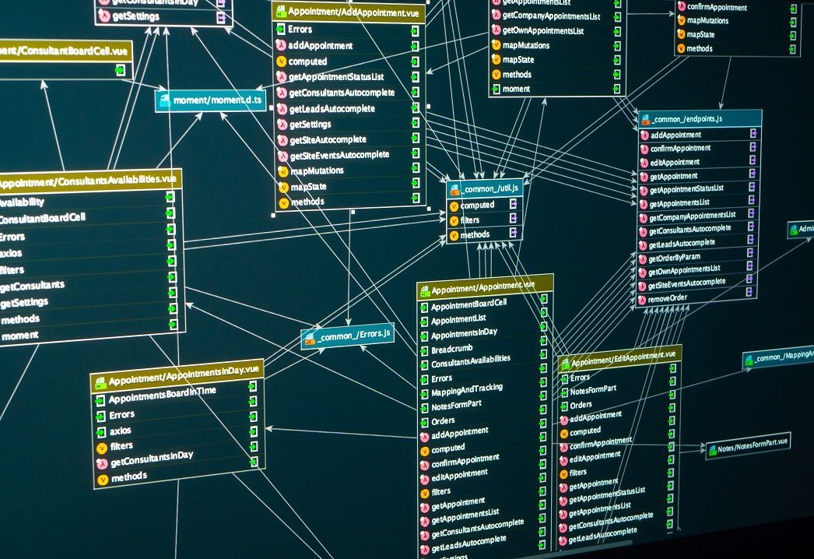
How can the CyDAS be used?
Trends,
Invasion history,
Distribution of species,
Impacts assessments (EICAT/SEICAT),
Horizon scanning exercises,
Prioritisation and coordination of management efforts,
Research e.g. detecting new alien species

Slide 18
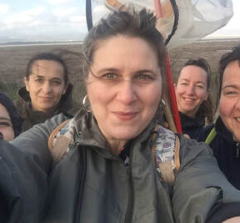
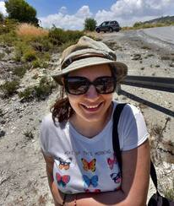
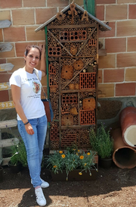
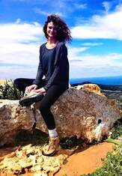
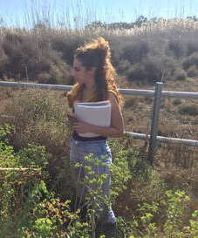
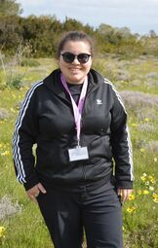
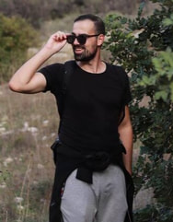
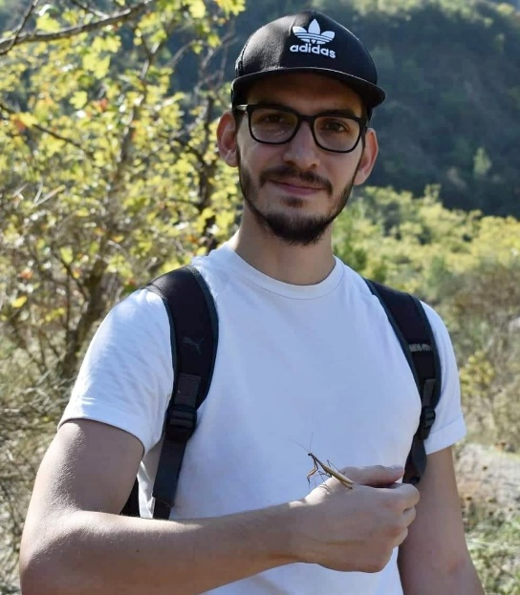
The team
Lab head:
Dr Kelly Martinou
Lab members (top left to bottom right):
Dr Andri Varnava
Dr Elli Tzirkalli
Ms Nicole Mavrovounioti MSc
Ms Ioanna Angelidou PhD student
Ms Katerina C. Athanasiou MSc student
Mr Evangelos Koutsoukos PhD student
Mr Jakovos Demetriou PhD student
Mr Andreas Josephides Computer scientist
Laboratory of Vector Ecology and Applied Entomology

Slide 19
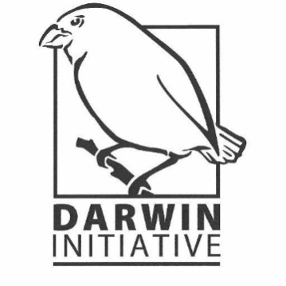
Collaborations and support
Got any questions? E-mail me at: jakovosdemetriou@gmail.com

Slide 20
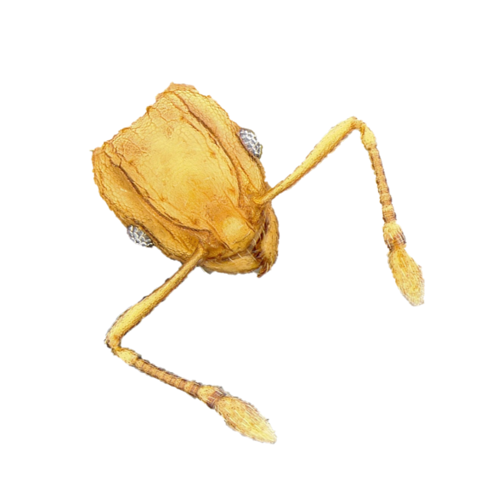
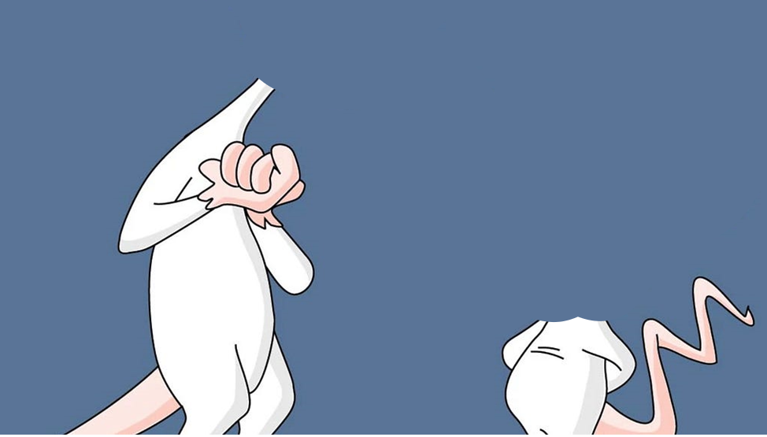
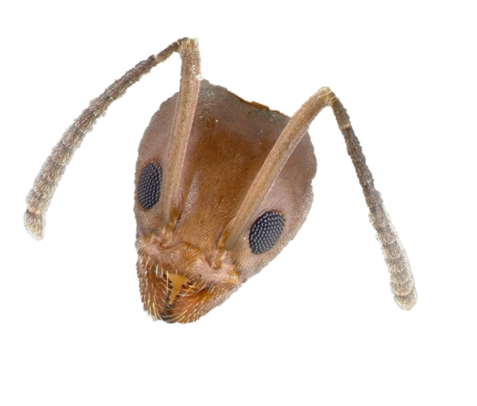
What are we going to do tonight Argentine ant?
The same thing we do every night little fire ant, try to take over the world!

