Slide 1
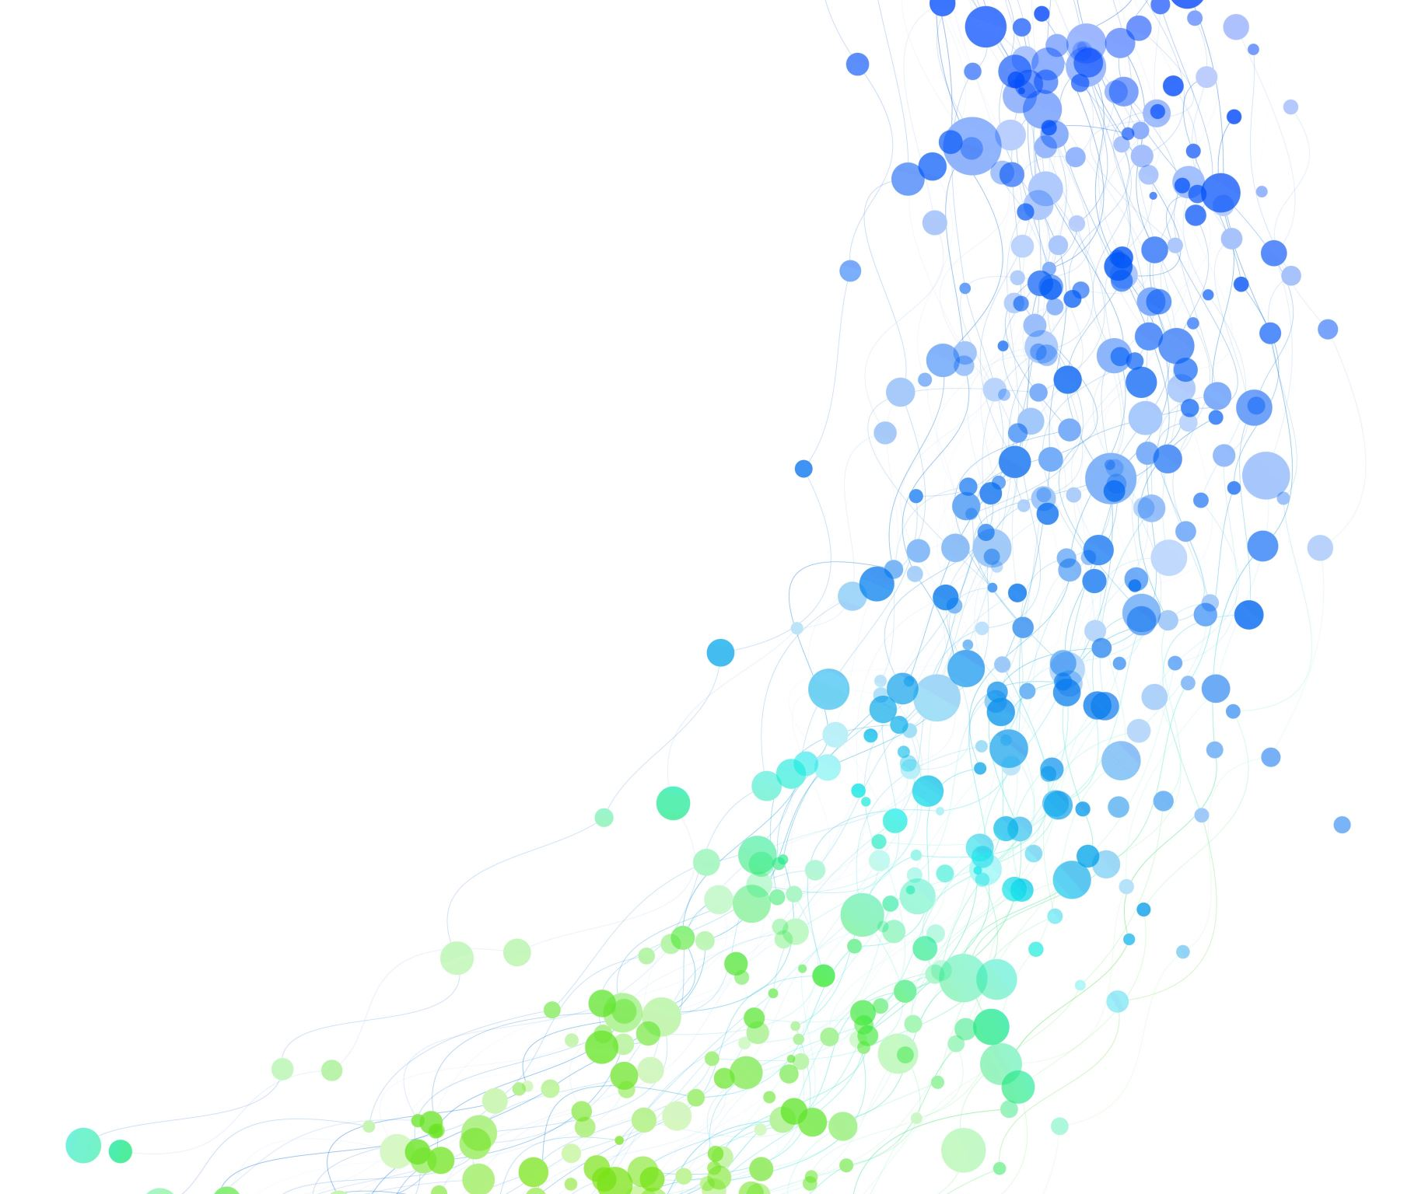
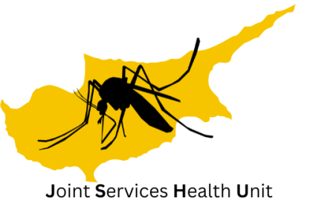
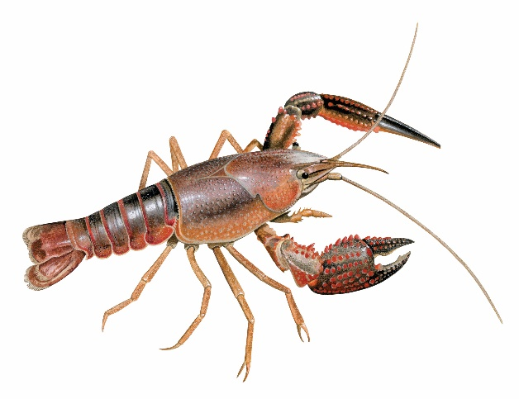
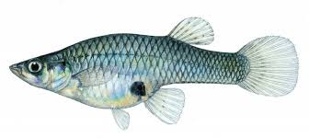
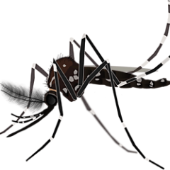
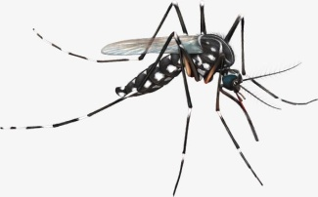
Progress on IAS research and Management at the Sovereign Base Areas in Cyprus
October 2023
Kelly Martinou PhD, FRES
Joint Services Health Unit
British Forces Cyprus
Angeliki.Martinou100@mod.gov.uk
Af.martinou@gmail.com
https://martinoulab.weebly.com/

Slide 2


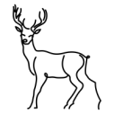







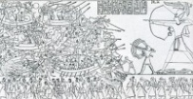
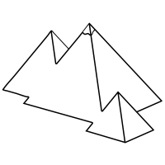

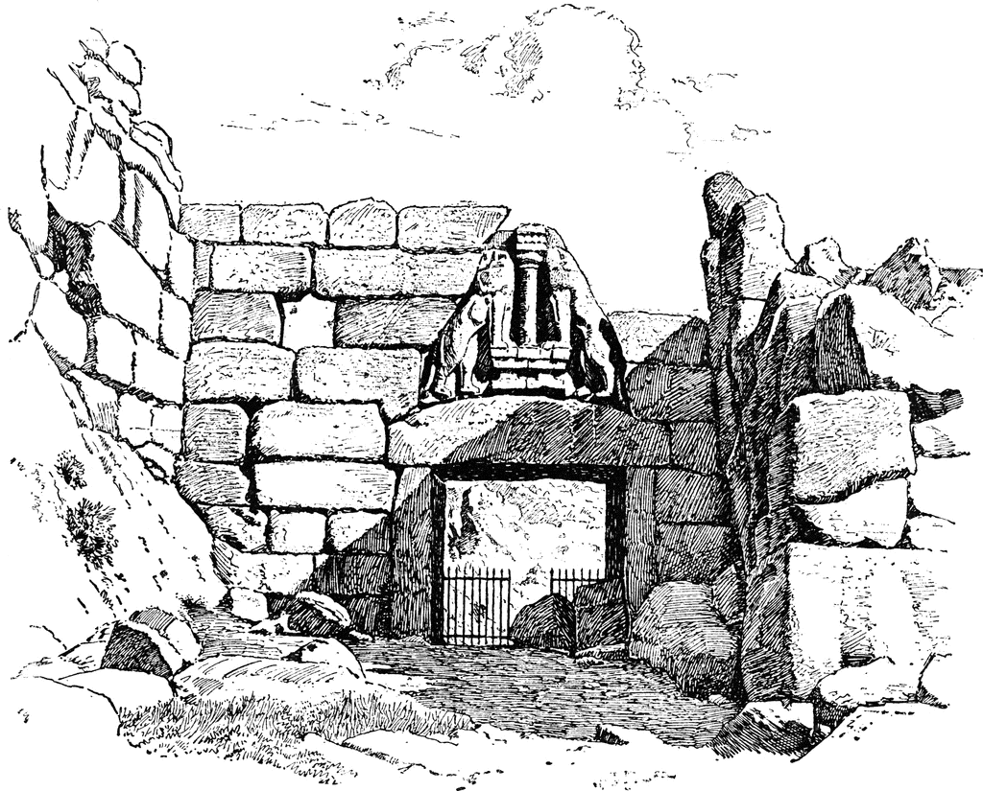
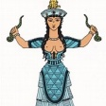






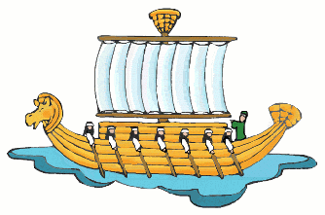


12000–11000 BCE
Hunter gatherers Aetokremnos
Extinction of pigmy and elephants, due to human presence
9500–8800 BCE Pre-Pottery Neolithic period & Farming
8700–7000 BCE 2nd migration from Anatolia 9,500 feline-human association
3800 BCE
Large earthquake hits Cyprus end of the Neolithic culture on the island
3500 BCE
First signs of metal work Chalcolithic period
1190 BC Invasion by the Sea Peoples
1300 BCE
Trade with Aegean "Aegeanization" Myceneans
1550 BCE Literacy introduced on Cypro-Minoan syllabary, first attested in Engomi
1600 BCE
First industrial centre in Cyprus at Engomi
Trade with Egypt
2250–1700 BCE Trade with Minoan Crete and the Levant
2450 BCE
Bronze Age Metallurgy
1179- 1050 BCE
Migrations of Aegean populations and Hellenization process
1000 BCE
Emergence of the City States, the Ten City-Kingdoms of Cyprus.
800 BCE Phoenician merchants settle in Kition
709 BCE
The Neo-Assyrian Empire of Ten Kingdoms of Cyprus forms
631 BCE
The Ten City Kingdoms of Cyprus declare independence from Assyrian
570 BCE
Cyprus conquered
by the Egyptians
525 BCE
The kingdoms pledge allegiance to Persian Empire in anticipation of his invasion of Egypt
30 BCE
Ptolemaic Dynasty ends Cyprus returns to Roman rule.
51 BCE Cyprus under Cleopatra and Julius Caesar
58 BCE
Cyprus becomes Roman province.
333 BCE
Liberated from Persians by Alexander the Great
450 BCE Phoenician establish
498 BCE The Persian army re-establishes control over Cyprus.
380 BCE Persia re-conquers Cyprus
499 BCE
Ionian Revolt against Persians Cyprus joins
1571 Cyprus is now subjected to Ottoman rule
.
1931
Greek
Cypriots demand
enosis with Greece
45
Cyprus converts to Christianity
395
Cyprus becomes part of the Byzantine Empire.
649
The Arabs invade and occupy Cyprus
1192
Richard I conquers Cyprus
1347
Black Death wipes out one fifth to one third of ipopulation
1489
Colony of the Venetian Republic
1869
The
Suez Canal opened
1878-1960 British occupation
2004
RoC
joins EU
Timeline of Cypriot history

Slide 3
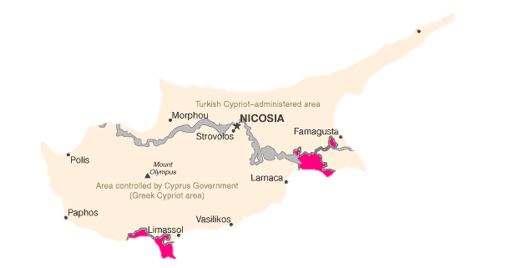
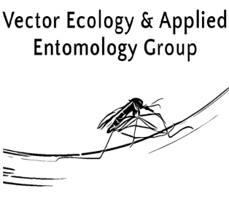
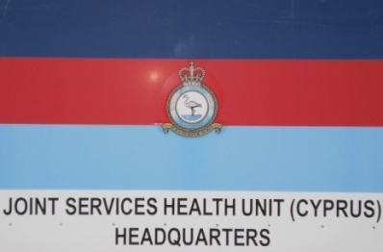
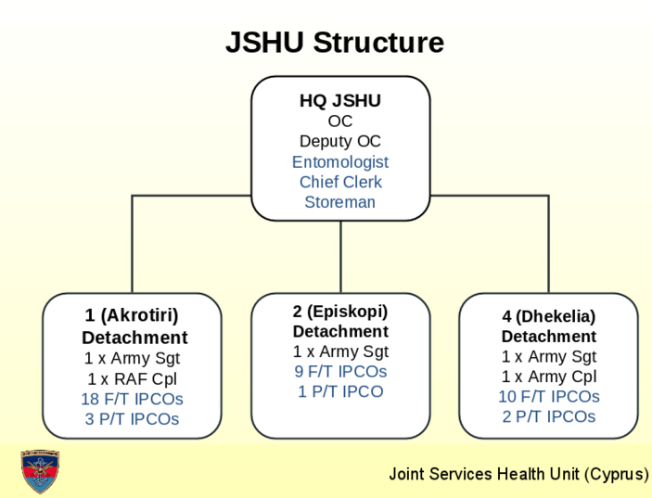
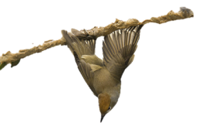
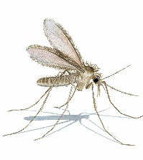
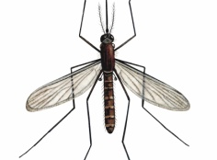
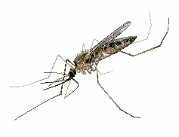
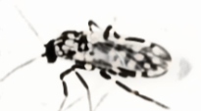
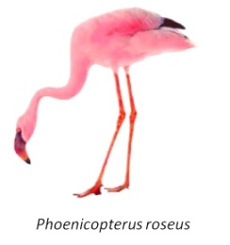
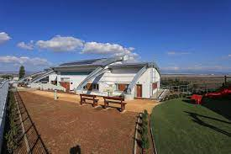

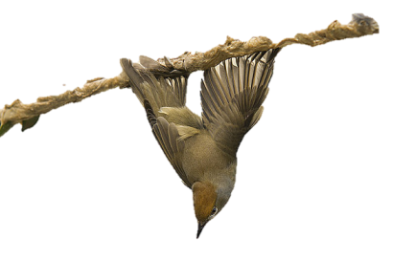

Sovereign Base Areas of Cyprus
My organization
Notes:
Joint Services is an environmental health unit of British Forces Cyprus and we are responsible for issues concerning human health around the British camps of Akrotiri, Episkopi and Dhekeleia. I am based at the headquarters which are in Akrotiri. We are in total about 80 members of staff military and civilian personnel

Slide 4
IAS efforts
Emphasis in knowing what IAS are present so
that we can manage them and understand their impacts on biodiversity, human health and services
Emphasis in preventing new introductions

Slide 5
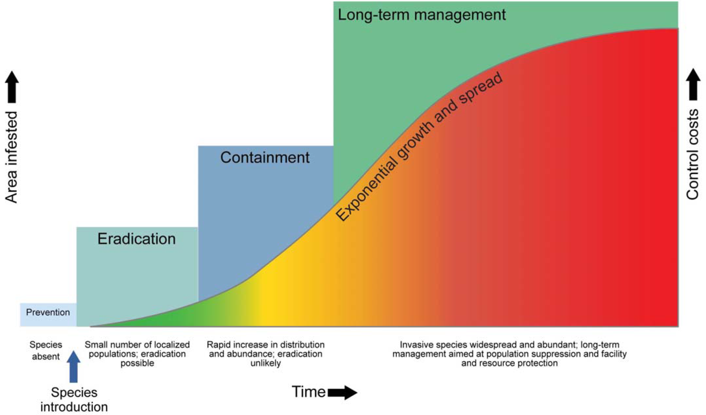
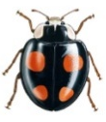
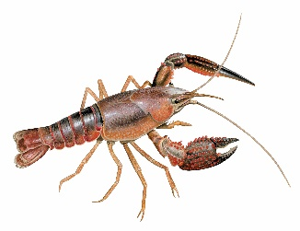




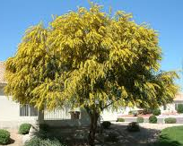
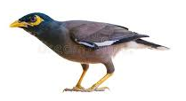
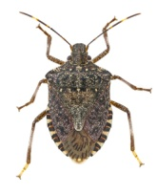
Emphasis on avoiding the introduction of invasive alien species and for the established IAS prioritizing management of those with negative impacts
Μακροπρόθεσμη διαχείριση
Εκθετική αύξηση και εξάπλωση
Περιορισμός
Εκρίζωση-Εξάλειψη
Πρόληψη
Strategies regarding IAS

Slide 6
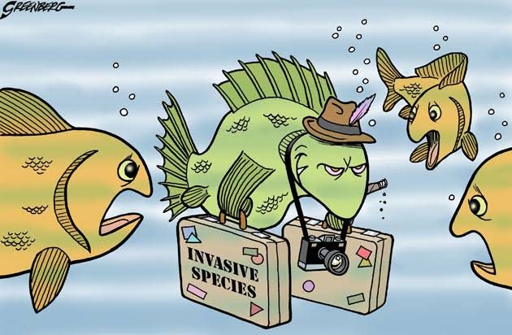
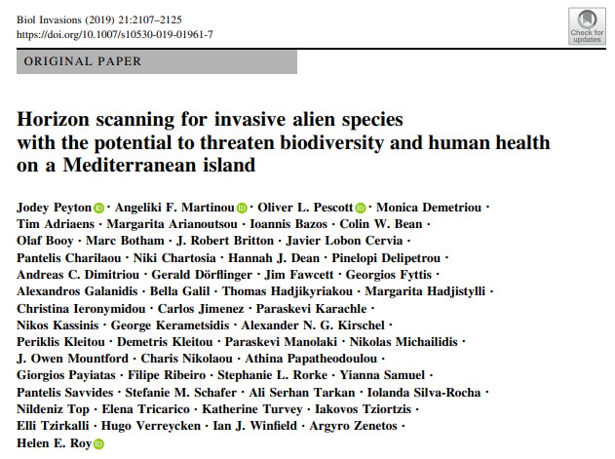
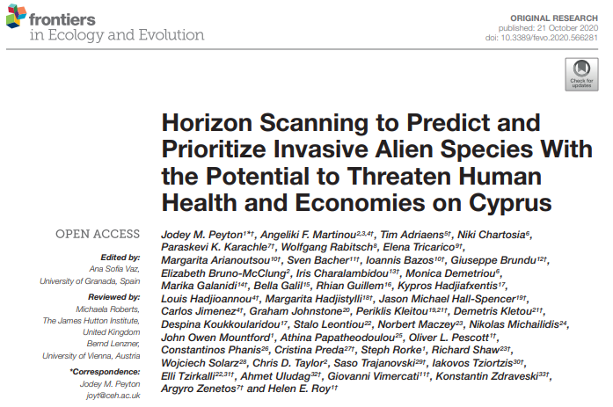
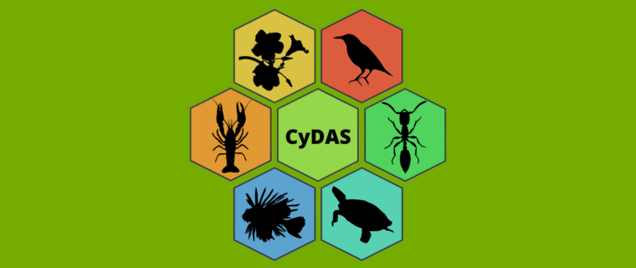
Horizon scanning exercises

Slide 7
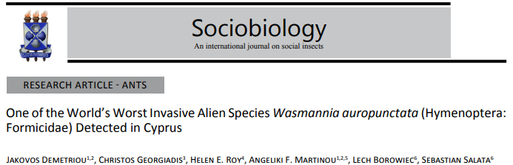
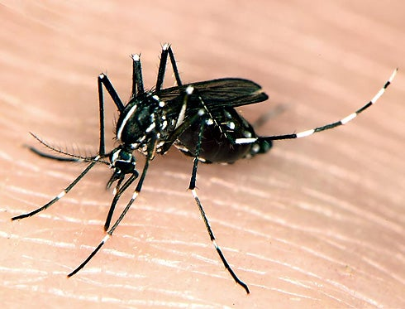
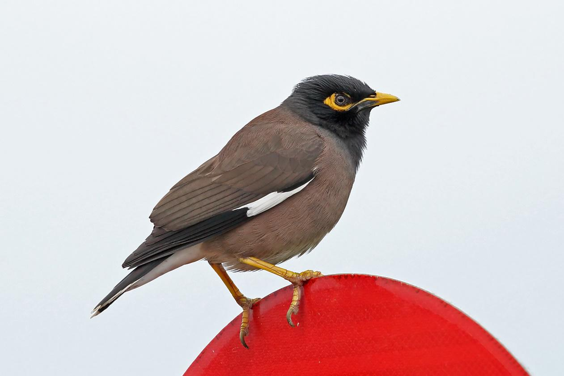
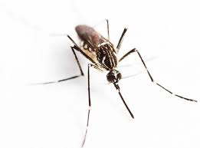
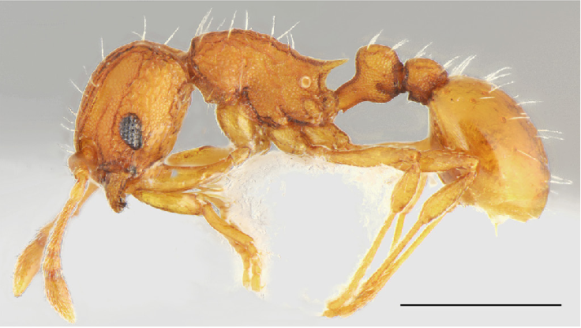
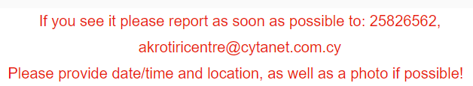
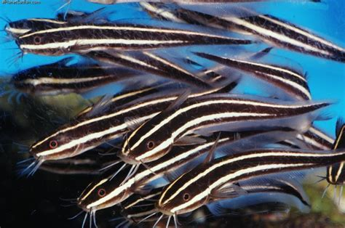

Horizon scanning exercises – new arrivals

Slide 8
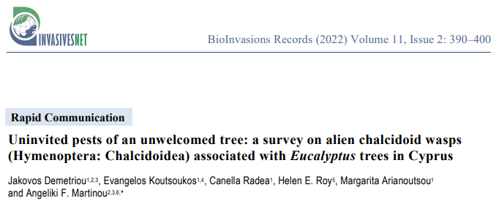
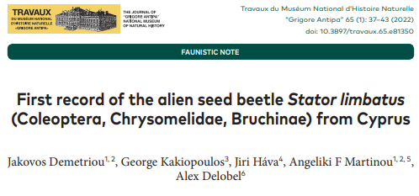
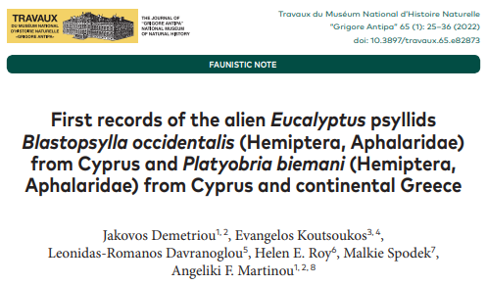
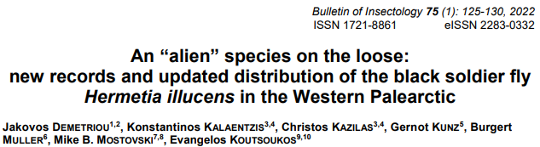
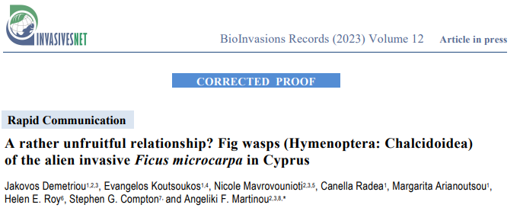
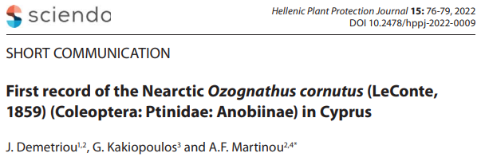

Slide 9
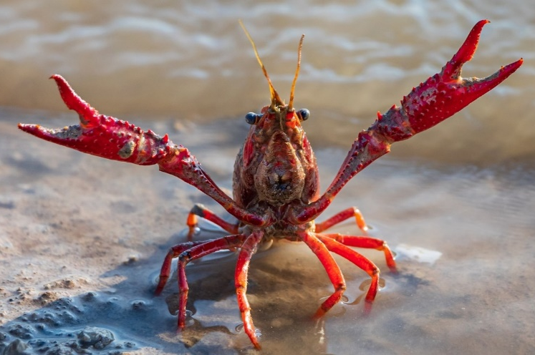
Biological Invasions
I WILL TAKE OVER THE WORLD!!!
More than 14,000 alien species in Europe.
How many are they in Cyprus?
Invasive species = main drivers of global biodiversity loss.
Adverse impacts on:
  native biodiversity and ecosystem functions,
  socioeconomic parameters,
  constituents of human health and well-being.
Need for up-to-date alien species inventories and databases pooling available data, enhancing monitoring activities, providing impact assessments and guiding management prioritisation.

Slide 10






The Cyprus Database of Alien Species

Slide 11

The story behind the platform
COST Action: Alien Challenge (COST TD1209) (2014 – 2018):
  Compilation of the offline database: Cyprus Invasive Alien Species (CY.I.A.S) inventory.
  Data pooled from published and unpublished material, online databases and projects i.e. DAISIE, EASIN, ELNAIS, and GBIF.
  Information on: introduction pathways, origin, establishment success, first sighting collection date, reference(s).
  At the time, CY.I.A.S contained 664 species (155 marine, 15 freshwater and 494 terrestrial species).
Researching the Invasive Species of Kýpros (RIS-Ký) project (2017 – 2021):
  Darwin Plus projects (DPLUS056, 088), funded by the UK government.
  CY.I.A.S was digitalised, supplemented and renamed as the Cyprus Database of Alien Species (CyDAS) (https://ris-ky.info/cydas).

Slide 12

The story behind the platform
Darwin Plus 124:
  Increasing local knowledge within the SBAs, Cyprus and beyond by providing accessible, user-friendly online resources through an online database alongside citizen-science to study native species-INNS interactions.
  01/07/2021 to 30/06/2023.
  Supervised by Dr Kelly Martinou and Prof Helen E Roy.
  CyDAS → species profiles for 1228 alien species: Tracheophyta (571 species), Arthropoda (400 species), Chordata (104 species), Mollusca (66 species).
  Updates on: first record year, references, occupied habitat etc.
  Promotion of biodiversity recording and CS activities to monitor alien species.
  New records of alien species for the island (particularly insects).

Slide 13
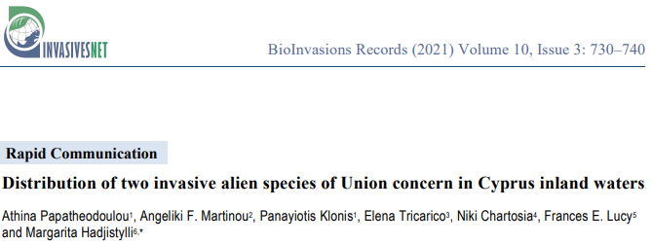
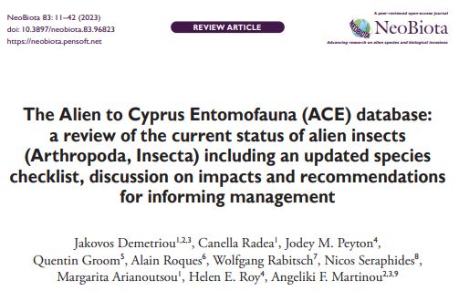





Slide 14
The platform

Slide 15


Slide 16




Slide 17


Slide 18


Slide 19


Slide 20



Further resources

Slide 21
Advantages and disadvantages of the CyDAS
Dynamic species inventory that allows quick editing of data and species.
iNaturalist project allows us to promote biodiversity recording and map the species distribution on the site (Researchgrade data are automatically uploaded to GBIF).
Data downloadable as .csv file (upon request).
Communication with GRIIS, EASIN and GBIF when updates are available.
Information source for both experts and non-experts.
Bugs (i.e. images size and appearance).
Species not present in GBIF or COL do not appear under taxonomic trees.
Interface based on taxonomy (not particularly friendly to non-taxonomists, although search tool is available).
Taxonomy of some species on GBIF is problematic.
Need for team of specialists for different organismic groups.

Slide 22

How can the CyDAS be used?
Trends,
Invasion history,
Distribution of species,
Impacts assessments (EICAT/SEICAT),
Horizon scanning exercises,
Prioritisation and coordination of management efforts,
Research e.g. detecting new alien species

Slide 23










The team
Lab head:
Dr Kelly Martinou
Lab members (top left to bottom right):
Dr Andri Varnava
Dr Elli Tzirkalli
Ms Nicole Mavrovounioti MSc
Ms Ioanna Angelidou PhD student
Ms Katerina C. Athanasiou MSc student
Mr Evangelos Koutsoukos PhD student
Mr Jakovos Demetriou PhD student
Mr Andreas Josephides Computer scientist
Laboratory of Vector Ecology and Applied Entomology

Slide 24




















Collaborations and support
Got any questions? E-mail me at: jakovosdemetriou@gmail.com

Slide 25




What are we going to do tonight Argentine ant?
The same thing we do every night little fire ant, try to take over the world!

