Slide 1
Climate change / Extreme weather impacts on invasive non-native species
Diana Bowler, UK Centre for Ecology & Hydrology

Slide 3
Temperature
Storms / Hurricanes
Climate
Wild fire
Sea level
Ocean O₂ / pH
Precipitation
Droughts

Slide 4
Increasing air and water temperature
Extreme Storms / Hurricanes
Increased frequency and intensity of wild fire
Climate Change
Increasing sea level
Decreasing ocean O₂ / pH
Decreasing mean precipitation but increasing extremes
Increasing droughts

Slide 5
Potential consequences
For species
Heat-related stress and mortality
For habitats/land cover
Reduce high elevation habitats
For people and human activities
Heat-related stress and mortality
Change species distributions
Increase dryland / scrubland
Affect trade, tourism and construction

Slide 6
Potential consequences
For species
Heat-related stress and mortality
For habitats/land cover
Reduce high elevation habitats
For people and human activities
Heat-related stress and mortality
Change species distributions
Increase dryland / scrubland
Affect trade, tourism and construction
Arrival, spread or establishment or impact of invasive species

Slide 7
How might the impacts of climate changes / extreme weather and invasive species interact with each other?

Slide 8
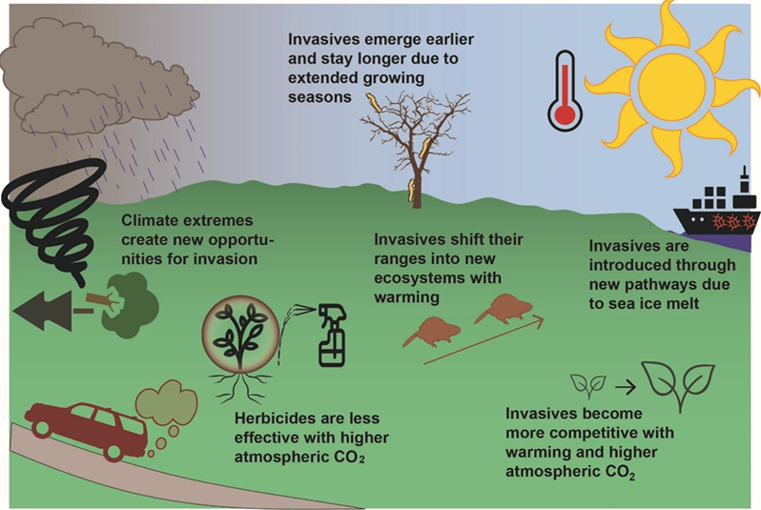

Slide 9
Hellman et al. 2008

Slide 10
Direct effect
Climate change / Exreme weather
Species survival, reprodution or dispersal
Notes:
The traits of species that make them invasive (i.e. abil- ity to survive in adverse conditions, rapid growth rates and wide dispersal) will often help them succeed in com- petition with native species under climate change

Slide 11
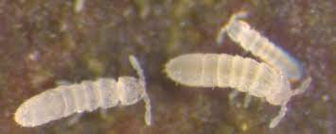
Example: Direct effect of increasing temperature Invasive springtails on Marion Island
Invasive species shown to be more tolerant of extreme temperatures than native species
--> climate change could favour their dominance in soil communities
Notes:
Sub-antartic island
displaced indigenous ones
species have mainly been introduced with ship cargo and building material

Slide 12
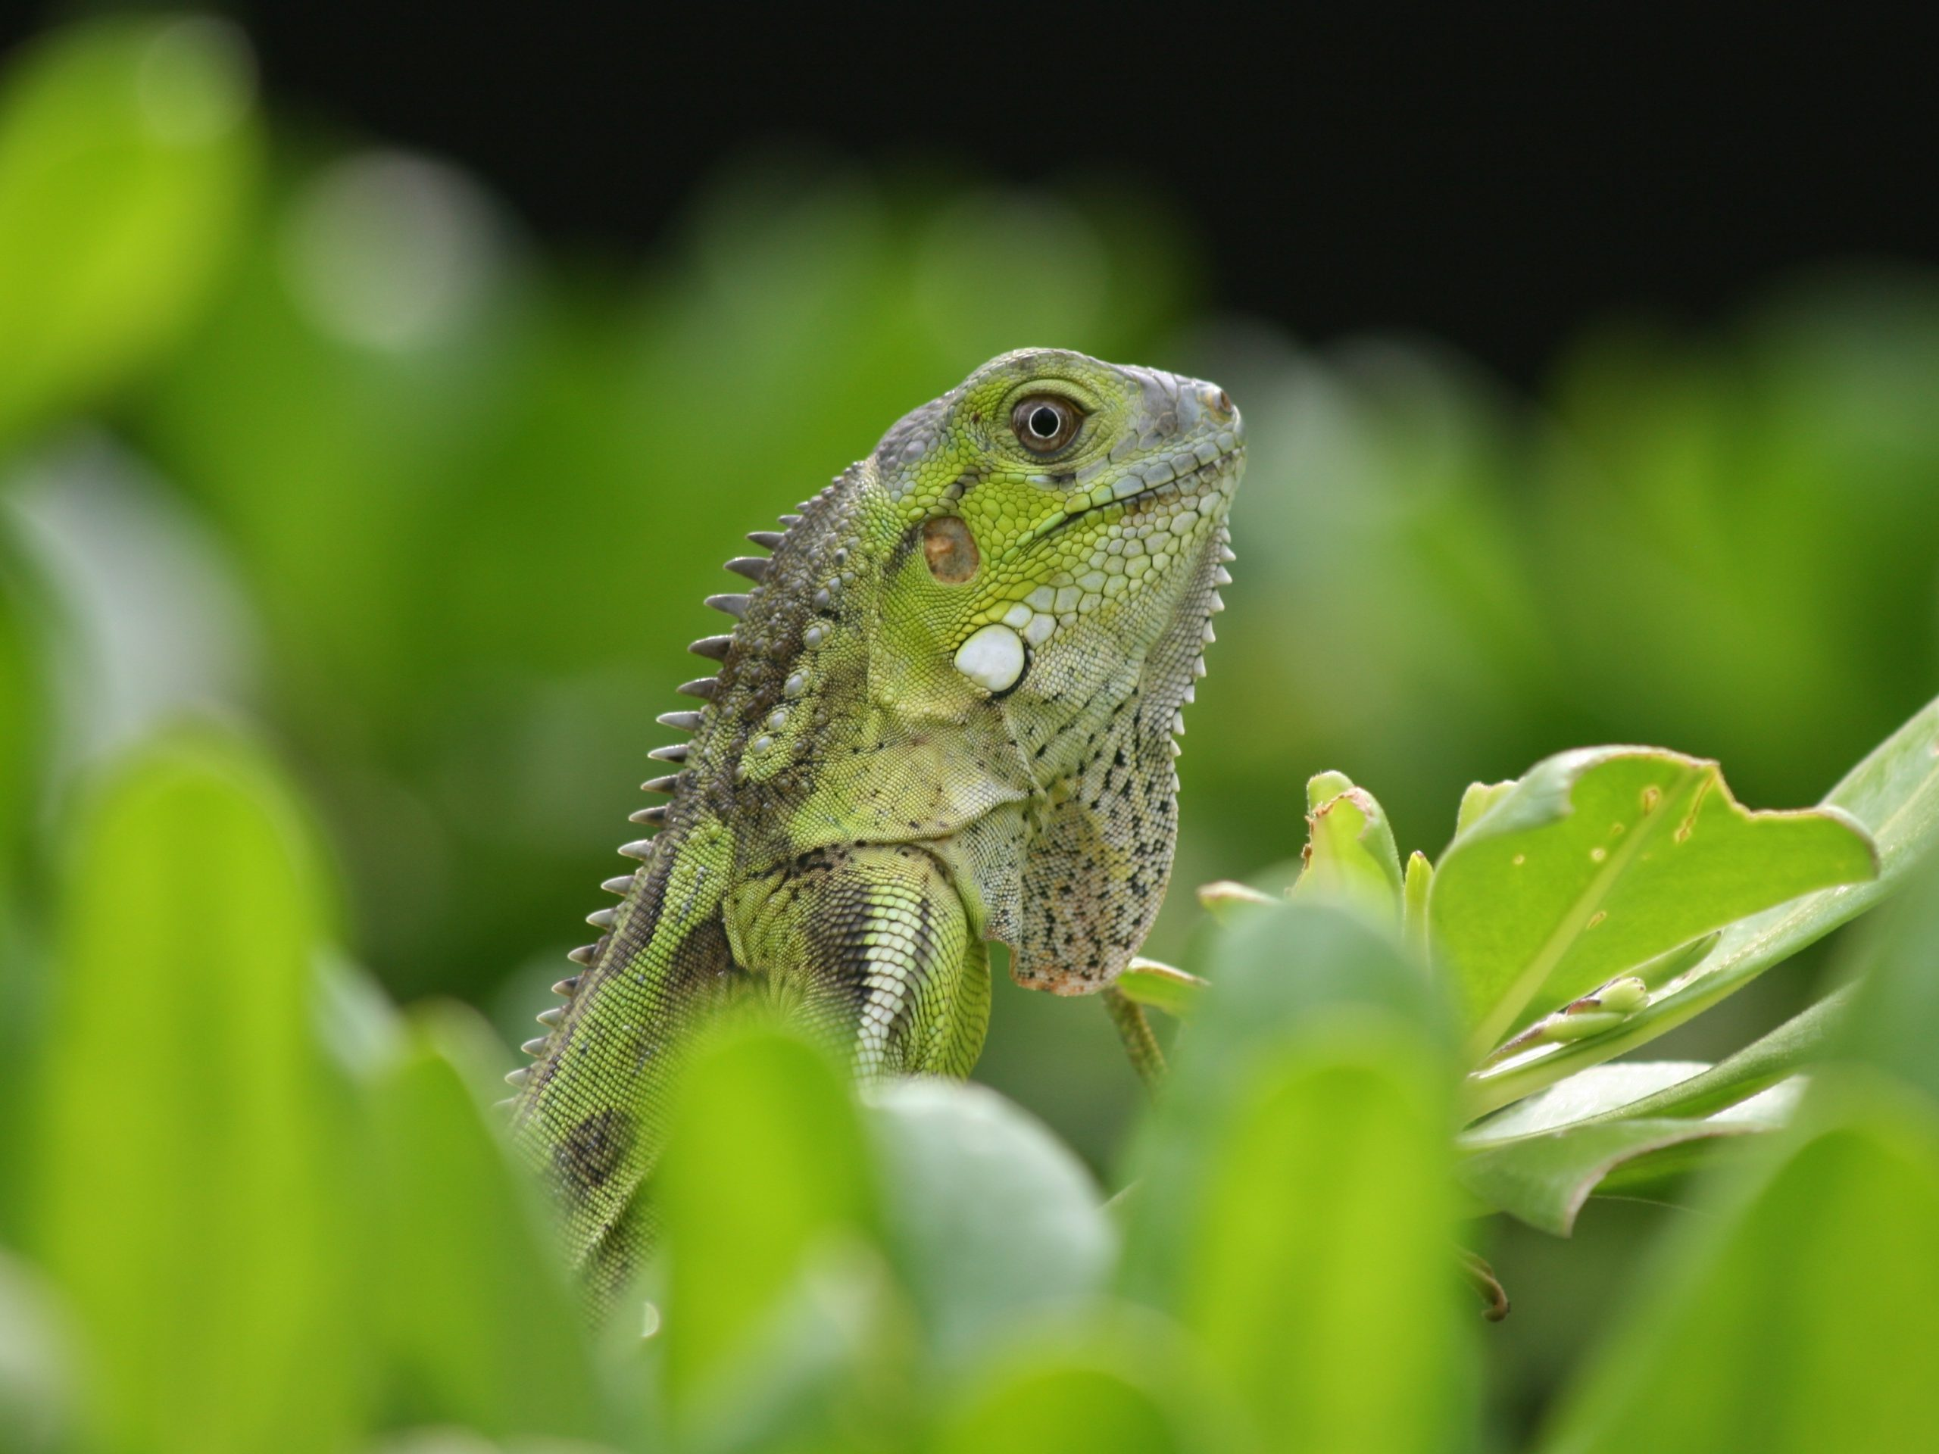
Example: Direct effect of hurricanes on movement Iguana in the Carribbean
Notes:
They arrived on a mat of logs and uprooted trees, some of which were more than 30 feet long and had large root masses.
Hurricane 1995

Slide 13
Indirect effect via changes in habitat
Climate change / Exreme weather
Changes in habitat or land cover
Species survival, reprodution or dispersal

Slide 14
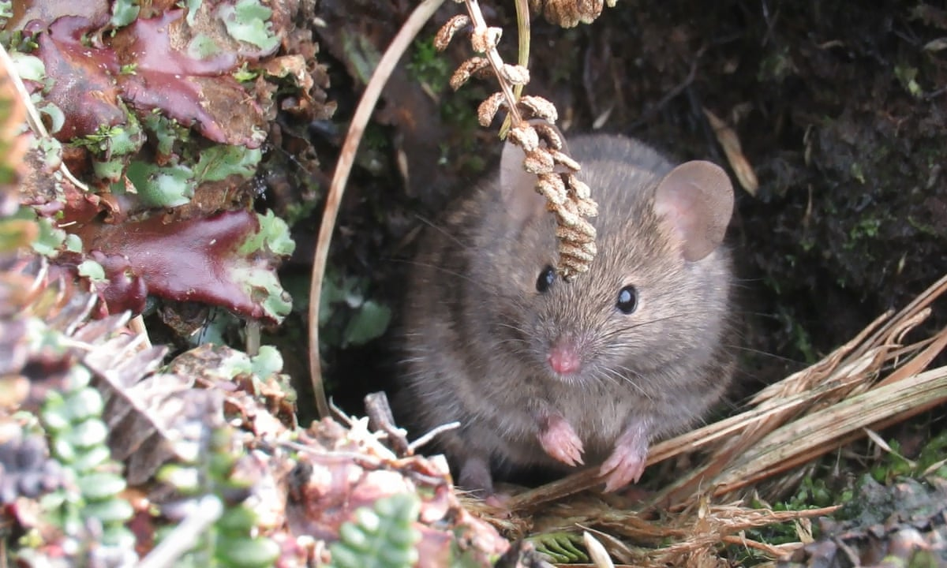
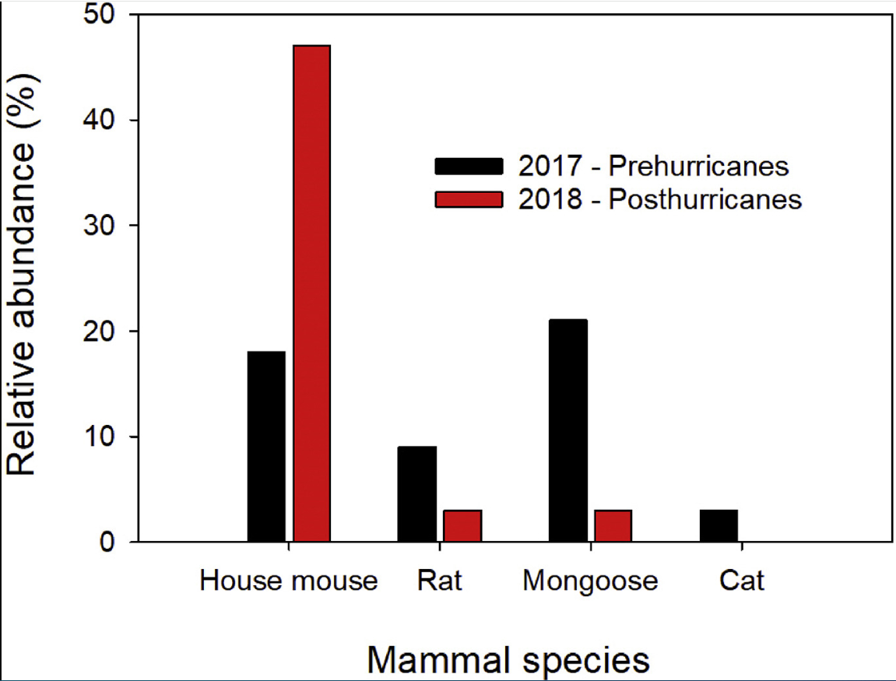
Example: Habitat changes due to hurricanes Spread of mice and rates in Carribean forests
Hurricanes create forest disturbance and change understorey vegetation
→ provide opportunities for mice and rats to spread

Slide 15
Indirect effect via human activities
Climate change / Exreme weather
People or human activities
Species survival, reprodution or dispersal

Slide 16
Example: changes in human activities Poorer biosecurity following extreme event
Incursion and establishment of two vertebrate IAS on Dominica during the aftermath of Hurricane Maria—the Common Green Iguana (Iguana iguana) and Cuban Treefrog (Osteopilus septentrionalis) in 2017
Notes:
esponding to the post-hurricane situation, countries and organizations provided a large range of aid including funds, medical and security support, and relief supplies
Though understandable given the human impact caused by severe weather events, these incursions suggest that biosecurity is not implemented by aid-facilitating countries and organizations

Slide 17
Indirect effect via effectiveness of management
Climate change / Exreme weather
Invasive species management
Species survival, reprodution or dispersal

Slide 18
Example: climate change affects biocontrol agent
Managers in Colorado are concerned that the saltcedar leaf beetle (Diorhabda elongata) will stop being effective at controlling Tamarisk (Tamarix ramosissima) if air temperatures increase
Notes:
his beetle is used in North America as a biological pest control agent against saltcedar or tamarisk (Tamarix spp.), an invasive species in arid and semiarid ecosystems

Slide 19
Feedback effect
Climate change / Exreme weather
impacts
Invasive species or management

Slide 20
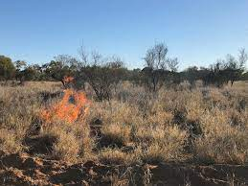
Warming-associated fires: Spread of buffel grass in Australia
Buffel grass (Cenchrus ciliaris) causes fire-mediated invasions across inland Australia.
Increases the fuel load causing hotter, larger fires:
increasing vegetation homogeneity and
killing native plants (e.g. river red gum, Eucalyptus camaldulensis).

Slide 21
Aims of day
Describe how climate change is affecting species, ecosystems and people of Montserrat (break out round 1)
Develop possible scenarios of how these changes will affect some exemplar invasive species (break out round 2)
Think about how climate change risks can be included in existing activities / workflows / assessments (final discussion)

Slide 22
Break out round 1: general climate change concerns
Impacts on species (Loss and damage to the coastal ecosystem, Loss of populations of native bird species , Loss of insect pollinators , Increases of plant pests, Loss of endemic animal and plant species )
Impacts on habitat/land use (Loss of cloud forest, Loss of other endemic habitats (e.g., coastal fringe, ridges and desert, Impact on farming and agriculture , Impacts on livestock and their grazing of land, Increased frequency of fire and fire-associated damage, Increased rates of erosion)
Impacts on human activity (Shortage of water for human consumption, Shortage of water for agriculture and irrigation , Disruption to ports / airports and shipping traffic / cargo, Damage to roads & infrastructure, Damage to settlements and buildings , Disruption & damage to the tourism and reduced cruise ships)

Slide 23
Break out round 2: develop scenarios
Pick a species to think about how it might be affected by climate change
(1) Direct pathway – Identify which climate change / weather variable is most important for the species/will the climate become more or less suitable for the species?
(2) Indirect pathway – What are possible indirect pathways? Which habitats and human activities affect the species and how will these change under climate change? Think about how the species is spread and whether that might be affected by climate change
(3) Record knowledge gaps as you discuss
(4) Make a prediction of whether the species will expand or contract with climate change

Slide 24
How can climate change risks on invasive species be communicated?
1) Invasive species risk assessment
2) Maps of potential ranges under climate change
3) Climate change infographics

Slide 25
1) Risk asessment templates

Slide 26
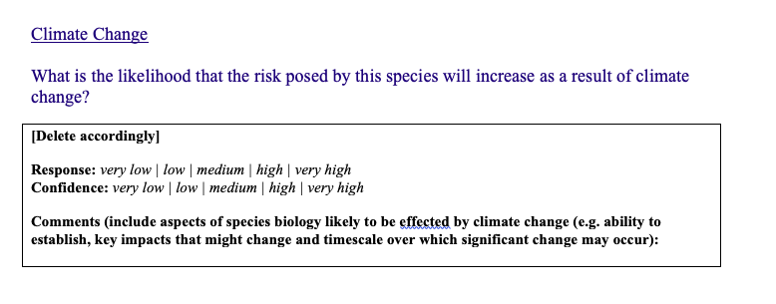
Including climate change

Slide 27
Risk asessment summary

Slide 28
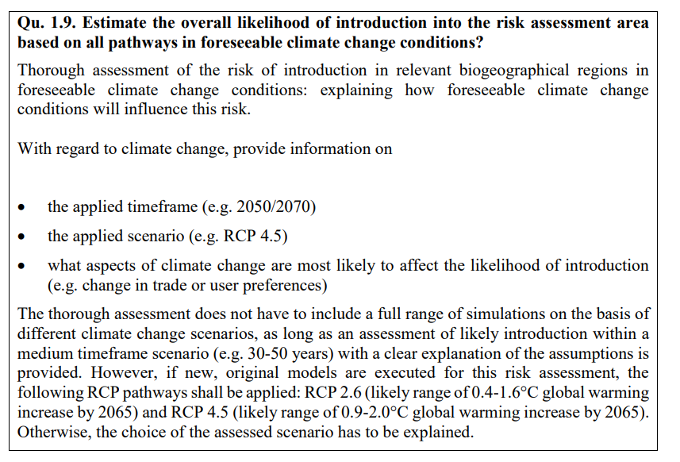
Existing tools
EPPO Pest Risk Assessment

Slide 29
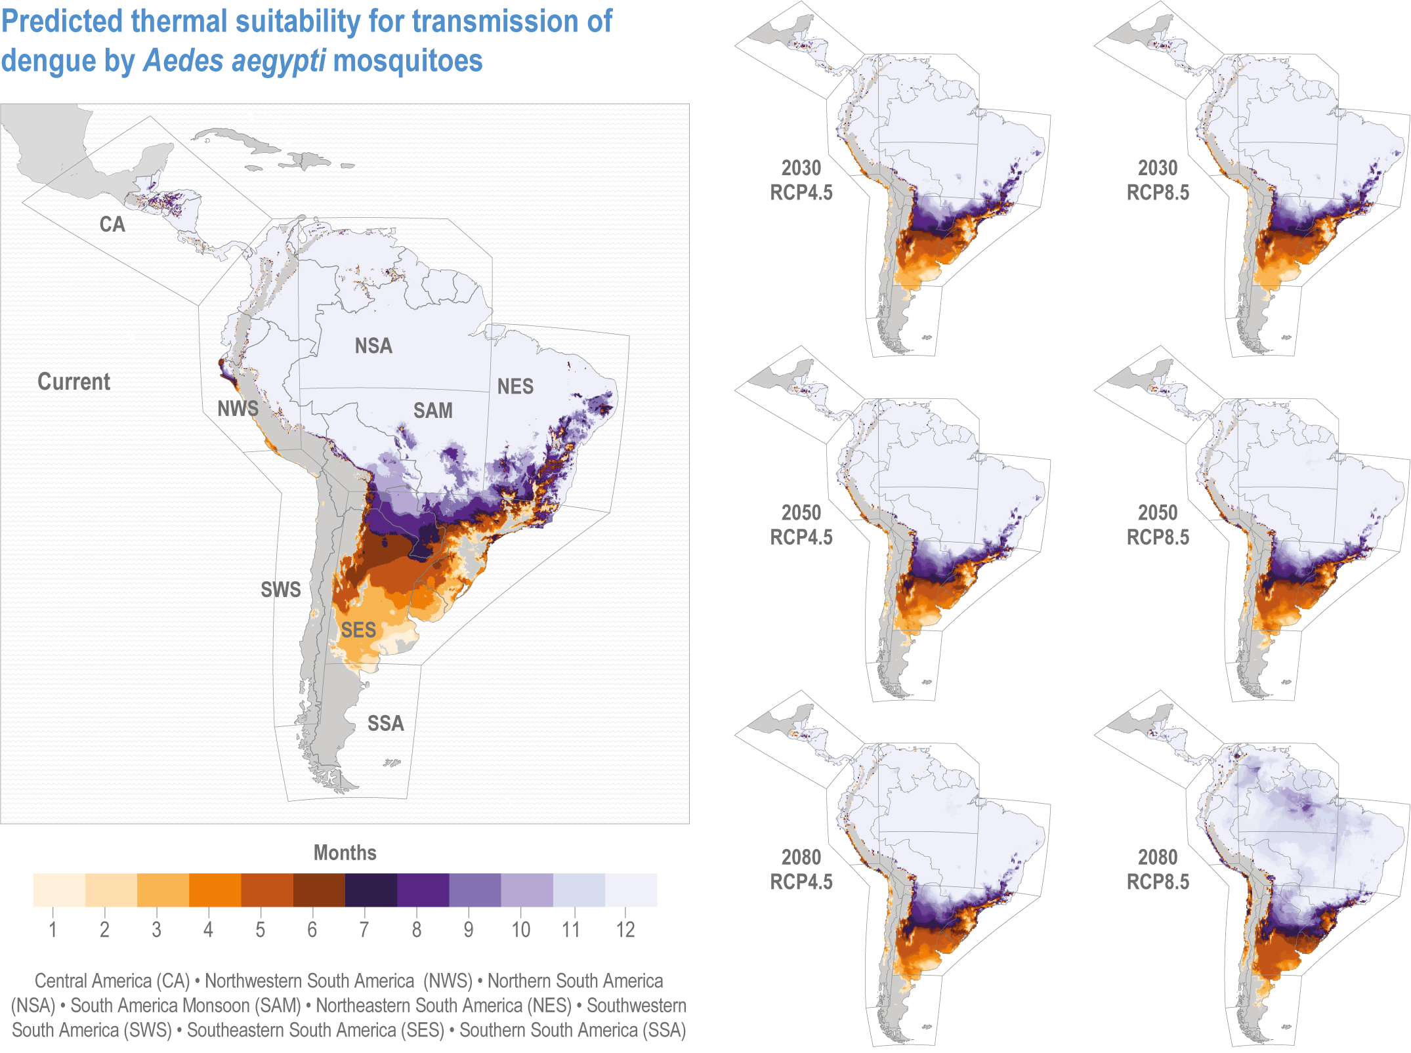
2) Projected distribution maps

Slide 30
3) Climate change info graphics

Slide 31
What are your needs for communicating climate change risks?

