Slide 1
Approaches to assessing impact of INNS
Helen Roy
Helen Roy

Slide 2
Why assess impact?
Tens of thousands of non-native species have established worldwide but only a small proportion become invasive
Major research priority in invasion biology has been to identify the
proportion of non-native species that become invasive
Important to support the prioritisation of their management and to support precautionary yet proportionate action that reduces the impacts of invasive non-native species while allowing the legitimate use of more benign species that provide economic and societal benefits

Slide 3
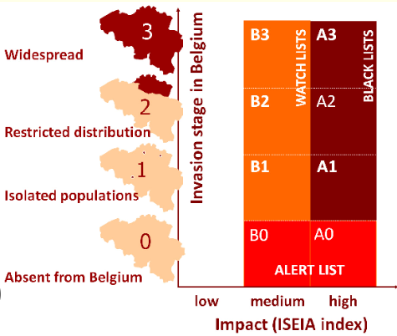
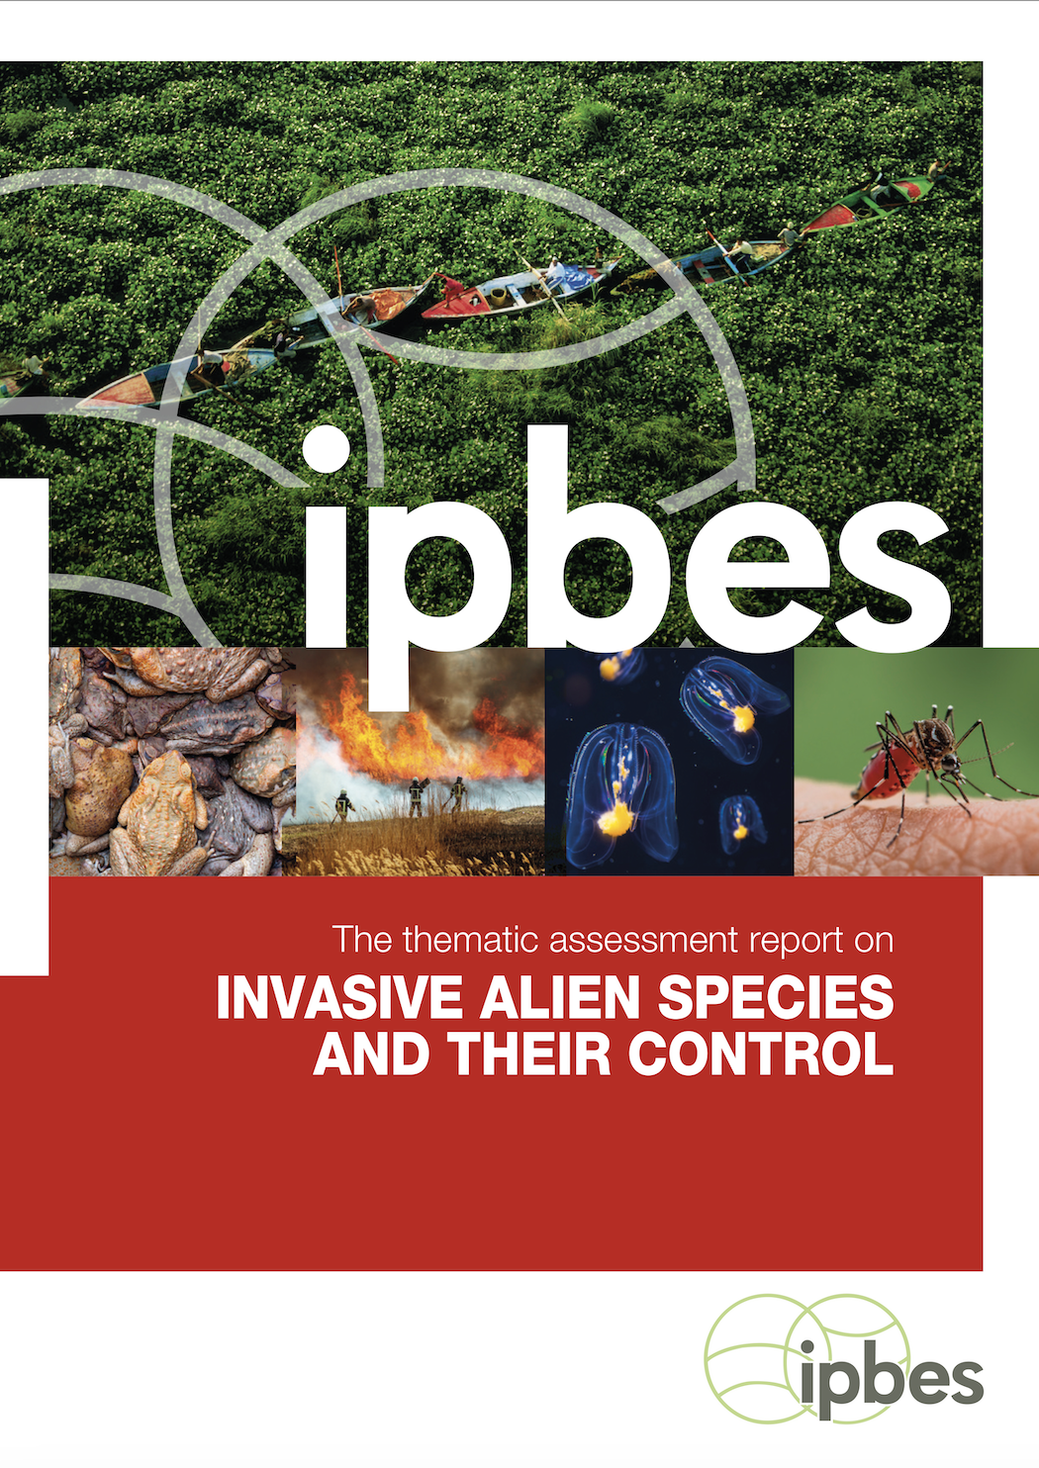
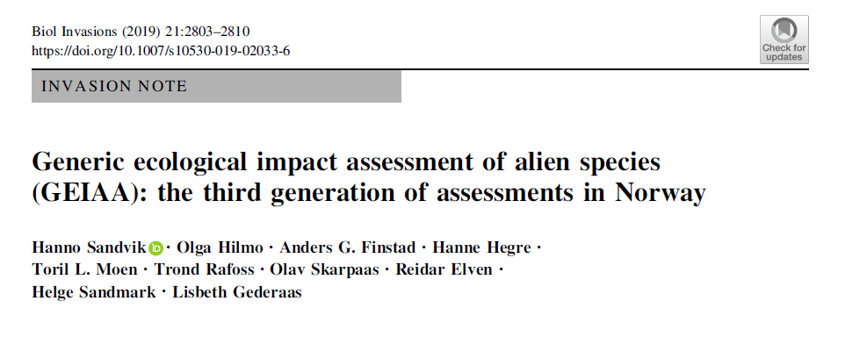
Approaches to assess impact

Slide 4
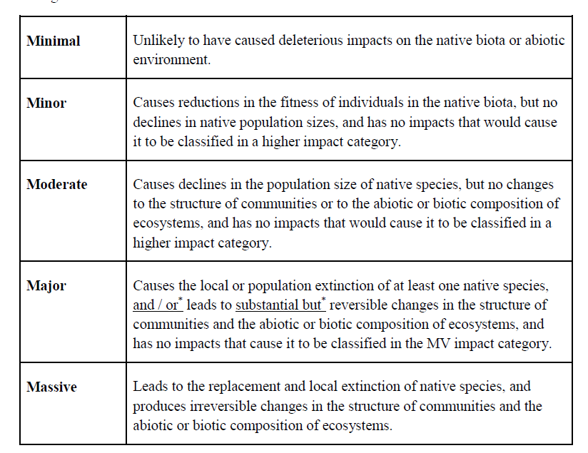
Approaches within horizon scanning and other studies

Slide 5
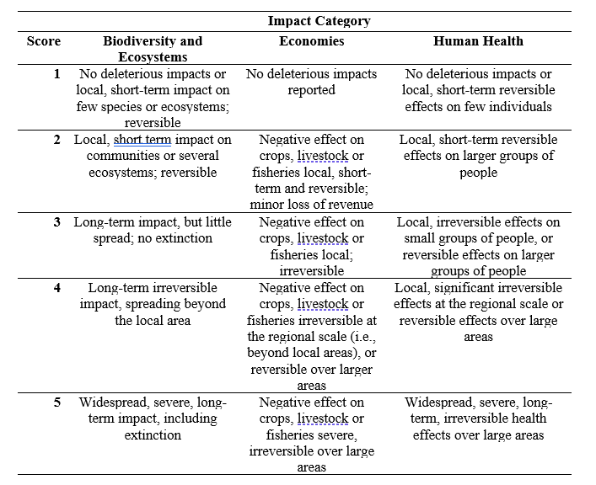

Slide 6
EICAT Environmental Impact Classification for Alien Taxa

Slide 7
What is EICAT?
A simple, objective and transparent method to classify alien taxa according to the magnitude and type of their detrimental environmental impact in recipient areas
Notes:
…according to the magnitude and type of their environmental impacts

Slide 8
EICAT can…
…help identify taxa with different levels of impact, and flag those with high impacts
…facilitate comparisons of impact among regions and taxa
…facilitate predictions of impacts
…aid in prioritisation of management actions
Notes:
…and flag those with high impacts

Slide 9
Impact criteria (mechanisms)
Competition
Predation
Hybridisation
Transmission of diseases
Parasitism
Poisoning/toxicity
Bio-fouling
Grazing/herbivory/browsing
Chemical, physical or structural impact on ecosystem
Interaction with other alien species
Notes:
Alien species can cause a large diversity of impacts, some of extremely severe nature. Examples…
So we could say we should just keep all alien species out, and eradicate all in order to get rid of their impacts and prevent them. However we all know that this is neither feasible nor desirable as many alien species have benefits. Most are actually introduced for their benefits in the first place. Therefore, prioritisation is key!

Slide 10
Competition
Massive
Major
Moderate
Minor
Minimal
 | Competition resulting in replacement or local extinction of one or several native species; changes in community composition are irreversible | Competition resulting in local or population extinction of at least one native species, leading to changes in community composition, but changes are reversible when the alien taxon is removed | Competition resulting in a decline of population size of at least one native species, but no changes in community composition | Competition affects fitness e.g., growth, reproduction, defence, immunocompetence of native individuals without decline of their populations | Negligible level of competition with native species; reduction of fitness of native individuals is not detectable

Slide 11
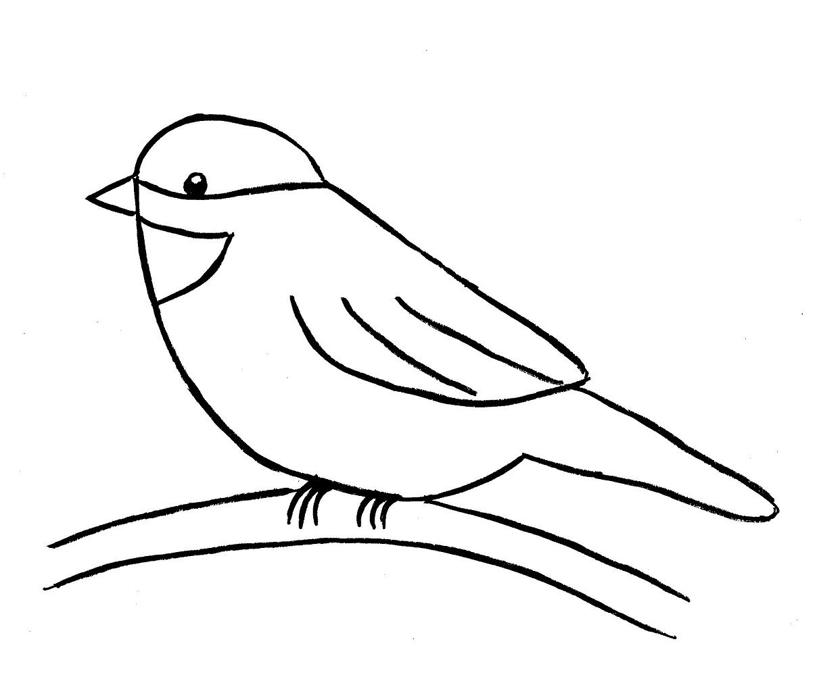
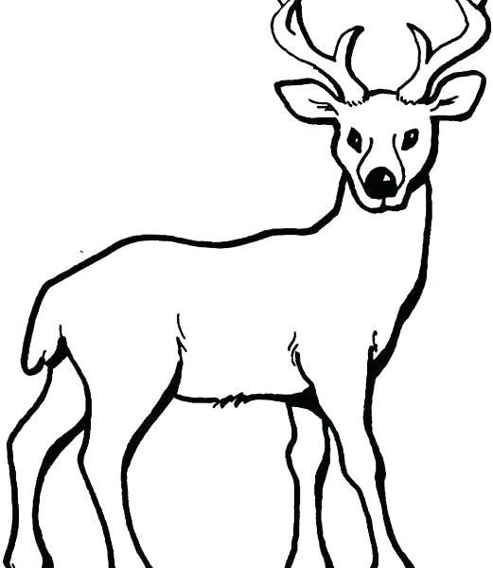
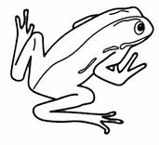
Taxa assessed

Slide 12
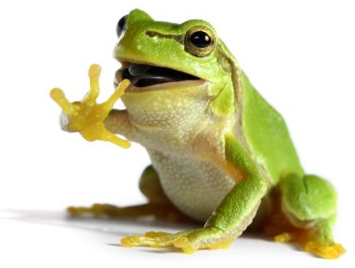
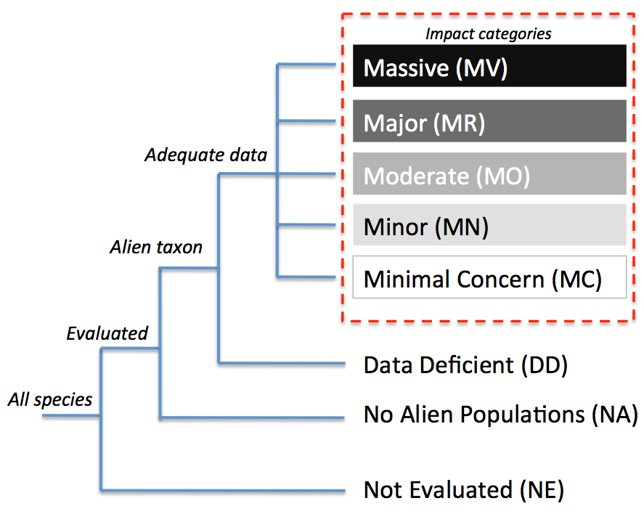
Amphibians
242 published sources
Impact data for ~37% of species (39)
<- 3 species
<- 8 species
<- 7 species
<- 18 species
104 species ->
<- 3 species
<- 65 species
7511 species ->
Kumschick et al. (2017) Neobiota

Slide 13
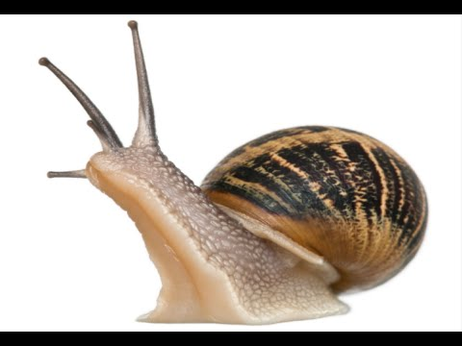
Gastropods (SA)
34 species assessed
146 published sources
<- 4
26 ->
<- 8
<- 12
<- 2
34 ->
<- 8
Kesner & Kumschick (2018) Ecol Evol

Slide 14
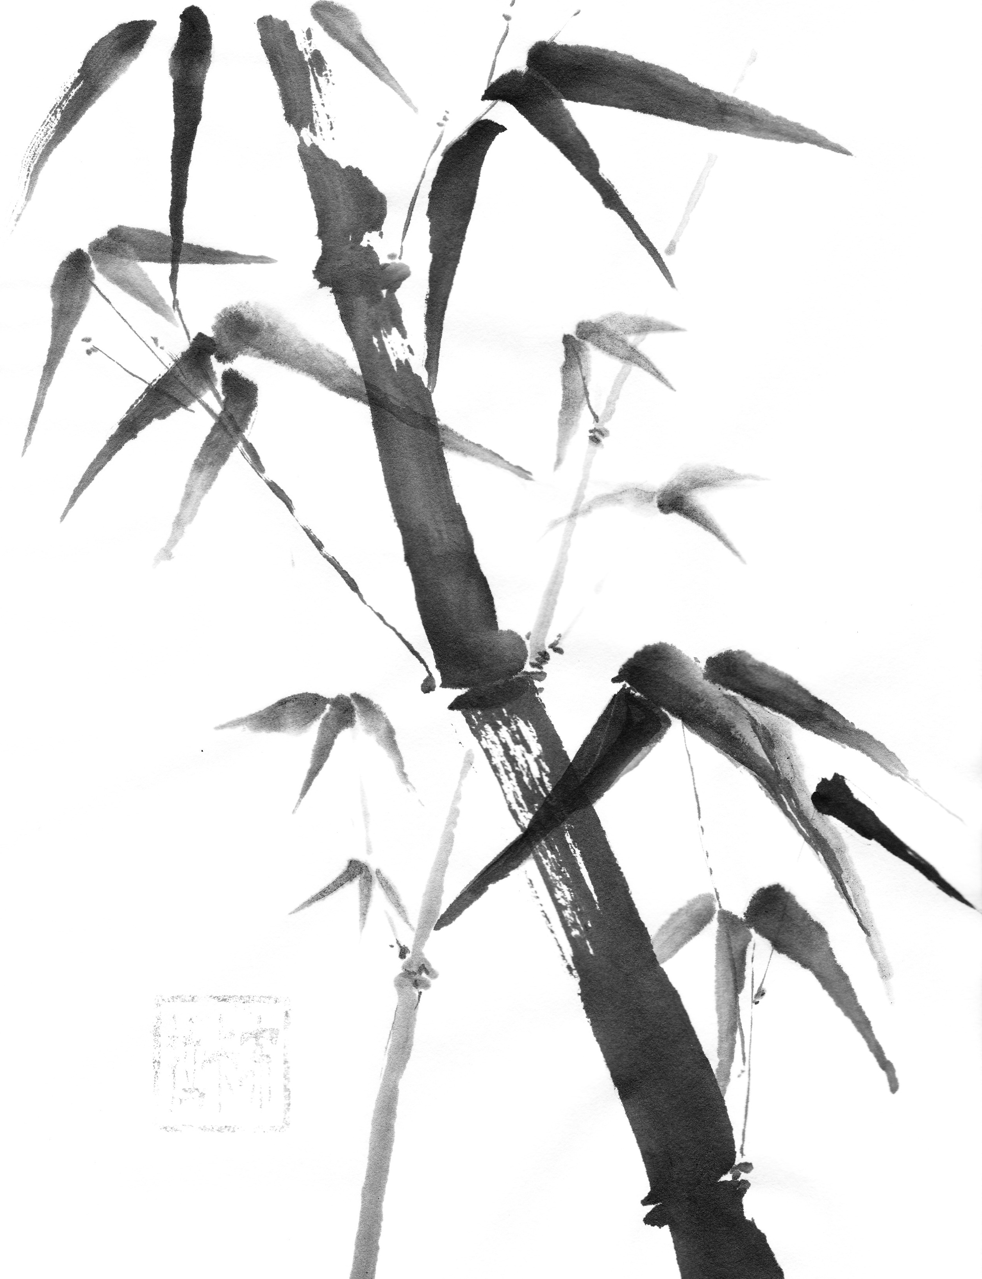
Bamboos
135 species assessed
66 published sources
Impact data for 20 species
Native and alien
<- 8
20 ->
<- 8
<- 3
<- 1
135 ->
<- 115
Canavan et al. (2019) Plants People Planet

Slide 15
Competition
Massive
Major
Moderate
Minor
Minimal
 | Competition resulting in replacement or local extinction of one or several native species; changes in community composition are irreversible | Competition resulting in local or population extinction of at least one native species, leading to changes in community composition, but changes are reversible when the alien taxon is removed | Competition resulting in a decline of population size of at least one native species, but no changes in community composition | Competition affects fitness e.g., growth, reproduction, defence, immunocompetence of native individuals without decline of their populations | Negligible level of competition with native species; reduction of fitness of native individuals is not detectable

Slide 16
Competition
The alien taxon competes with native taxa for resources (e.g. food, water, space), leading to deleterious impact on native taxa.

Slide 17
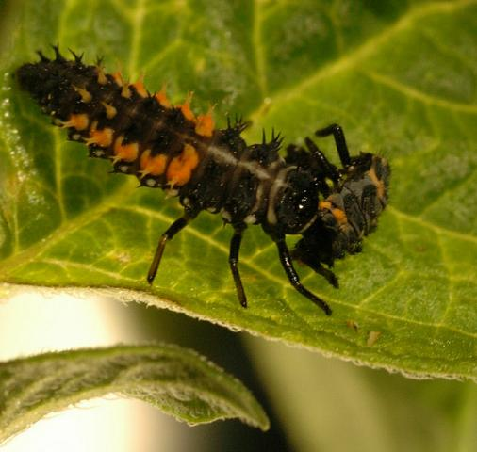
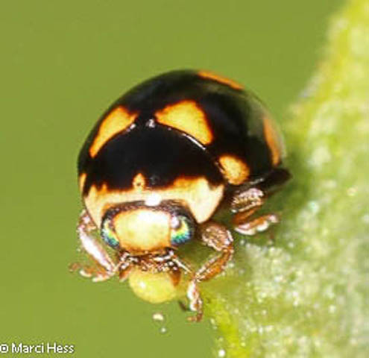
Harmonia axyridis
Brachiacantha ursina

Slide 18
“Coccinellid species typical of early successional and arboreal habitats showed a decline in abundance after the arrival of H. axyridis (Table 1). That was true for Brachiacantha ursina (F.) (Fig. IE) and Cycloneda munda (Say) (Fig. 1H)”

Slide 19
Competition
Massive
Major
Moderate
Minor
Minimal
 | Competition resulting in replacement or local extinction of one or several native species; changes in community composition are irreversible | Competition resulting in local or population extinction of at least one native species, leading to changes in community composition, but changes are reversible when the alien taxon is removed | Competition resulting in a decline of population size of at least one native species, but no changes in community composition | Competition affects fitness e.g., growth, reproduction, defence, immunocompetenceof native individuals without decline of their populations | Negligible level of competition with native species; reduction of fitness of native individuals is not detectable

Slide 20
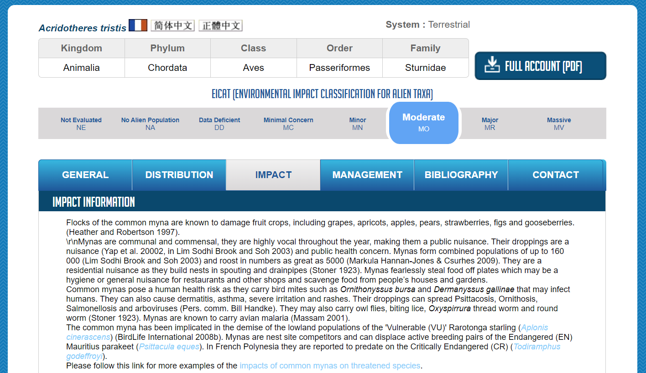
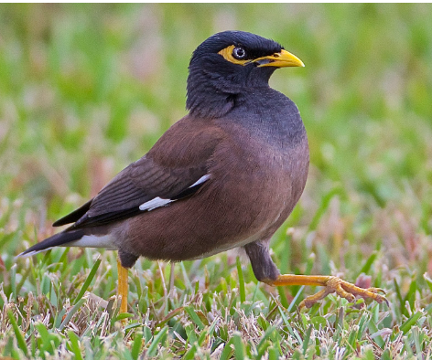
Global Invasive Species Database

