Slide 1
Emerging tools and technologies for ecology and monitoring
Diana Bowler, UK Centre for Ecology & Hydrology

Slide 2
Computer vision

Slide 3
Computer vision
Images with camera or video
Automatic detection and counting of individuals
Automatic species identification
Real-time monitoring

Slide 4
AMI-trap in action
Credit: Maxim Larriveé

Slide 5
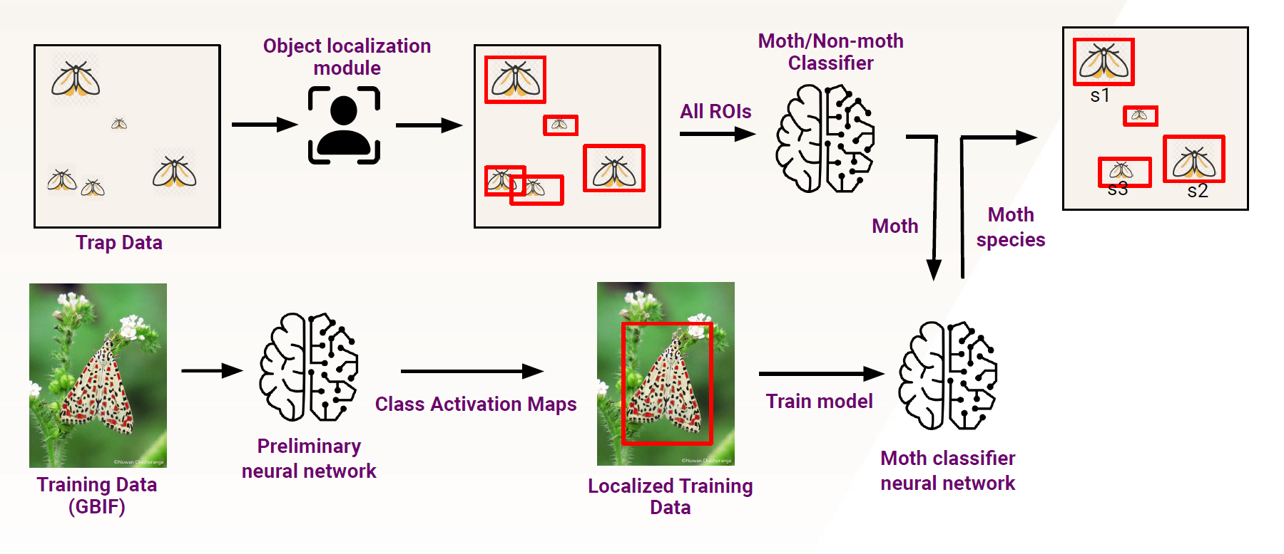
AI workflow

Slide 6
CV for real-time field sampling

Slide 7
CV for sample sorting in the lab

Slide 8
Using CV to study interactions

Slide 9
CV embedded within some Citizen Science App
Automated species identification

Slide 10
Acoustic sensors

Slide 11
Acoustic sensors
Acoustic recorders
Record sounds in the landscape (mix of species and other sounds)
Large detection range than computer vision

Slide 12
What can these data tell us?
Species identification
Activity patttern
Real-time tracking of threats

Slide 13
Taxonomic scope
Bats
Birds
Orthoptera
Frogs
Small mammals
Freshwater insects
Mosquitoes
Hoverflies/bees
More!!

Slide 14
Audio-moth

Slide 15
Monitoring invasives in Puerto Rico
Monitoring of invasive species including:
goat, horse, chickens, shiny cowbirds, cuban tree frog ….

Slide 16
Molecular methods

Slide 17
Molecular methods
Samples of organisms
Or substrate in which the organism is found
Detect DNA in the sample and idenfity species from that
Identifcation rates vary across taxa depending on how well reference libraries are developing

Slide 18
Environmental DNA

Slide 19
Already being testing….

Slide 20
Remote sensing methods

Slide 21
Drones/remote imagery
For habitat mapping
Especially useful for large species e.g., counting number of birds in a colony

Slide 22
Underwater drones

Slide 23
In combination with computer vision
Image taken above a forest in Hawaii

Slide 24
Pros and cons of new tech
Pros:
Reduces human effort
Removes some of the barriers of taxonomic ID skills
Creates new ways for people to be involved, esp citizen scientists
THEY ARE FUTURE! In combination with traditional sampling
Cons:
Still in development
Some more expensive but they are developing all the time

Slide 25
What are the monitoring opportunities for you?
Promote iNaturalist of other Citizen Science ?
Extend current professional monitoring schemes to include non-native species ?
Develop new schemes with new technologies (e.g., eDNA) ?
Improve mobilization of existing data of non-native species data e.g., using databases ?
Improve documentation of species impacts, including their interactions with native species ?
Other?

