Slide 1
Overview of approaches to reporting and summarising invasive non-native species data
Diana Bowler, UK Centre for Ecology & Hydrology

Slide 2
Summarising data for conservation and environmental planning
Raw data
Standardized workflow
Data-based outputs and indicators

Slide 3
Summarising data for conservation and environmental planning
Raw data
Standardized workflow
Data-based outputs and indicators
Checklist data
Geographic occurrence records
Trait data

Slide 4
Summarising data for conservation and environmental planning
Raw data
Standardized workflow
Data-based outputs and indicators
Raising-awareness
Official reporting
Scientific research
Inform conservation action
Inform land-use decisions

Slide 5
Outputs based on checklist data

Slide 6
Checklist data: list of known invasive non-native species in a country
Scientific name | Author
Abelmoschus esculentus | Moench
Abutilon hirtum
Abutilon indicum | Sweet
Acacia farnesiana | (L.) Willd.
Acacia macracantha | Humb. & Bonpl. ex Willd.
Acacia nilotica | Schumach. & Thonn.
Acalypha alnifolia | J.G.Klein
Achyranthes aspera | L.
Adonidia merrillii | Becc.
Aedes aegypti | Linnaeus, 1762
Agave beauleriana | Jacobi
Agave sisalana | Perrine
Albizia lebbeck | (L.) Benth.
etc….

Slide 7
Output: number of invasive species by taxon group
Data for St Helena taken from GRIIS

Slide 8
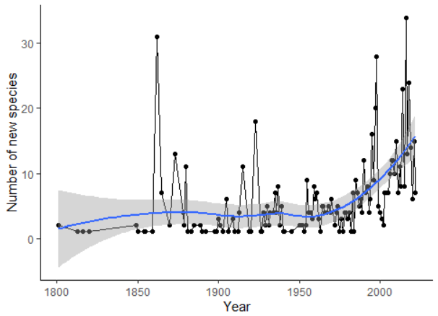
Output: change in number of new species through time
Needs data on year(s) of arrival/establishment for each species
Data for Cyprus from the CYDAS database

Slide 9
Outputs based on geographic occurrence records

Slide 10
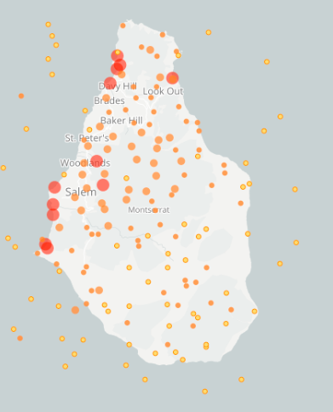
Geographic occurrence records

Slide 11
Output: mapping and predicting distributions
Maps for showing where a species is present
OR
Maps for showing where a species could be (i.e. area of suitable habitat)
Predict where monitoring and action should be targeted!

Slide 12
Making use of trait data

Slide 13
Trait data
„Trait“ – characteristics of a species
Useful traits in the context of invasive non-native species:
Habitat preference
Life history
Species interactions

Slide 14
Trait data
„Trait“ – characteristics of a species
Example: Acacia saligna
Habitat preference: Spiny Mediterranean; Shrub plantations
Life history: 10-20 years
Species interactions: Competes with native flora
Use these information to refine pressure indicators and inform conservation action

Slide 15
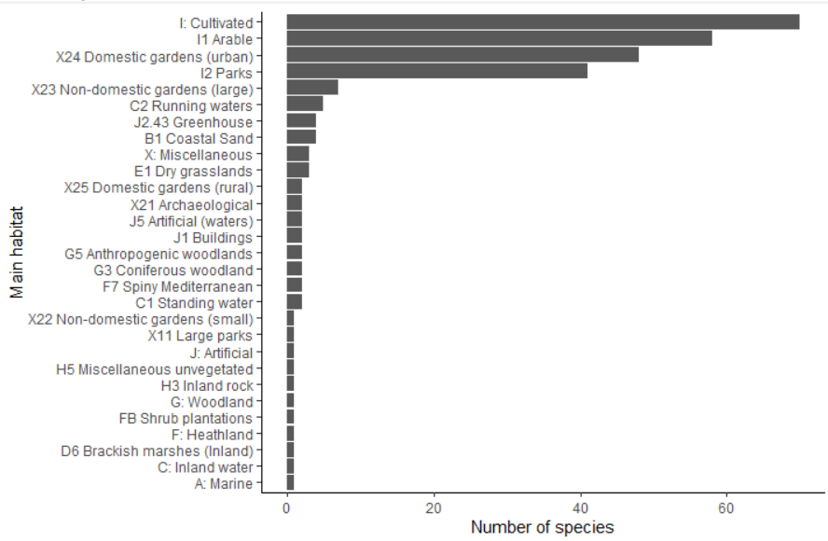
Output: number of invasive species by habitat
Data for Cyprus from the CYDAS database

Slide 16
Outputs combining all these data sources

Slide 17
Output: Species-level factsheets
Tool for raising awareness and communication!

Slide 18
Miniguides

Slide 19
Possible users?
Possible uses?
Raise awareness of the impact of non-native species?
Official reporting towards targets ?
Research on trends and state of nature?
Land use decisions?
Inform conservation action, including control of invasive species or habitat restoration?
What else….?
Local community?
Community groups?
Schools?
Government agencies?
Non-governmental agencies?
Who else….?

Slide 20
What reports, visualisations or other outputs would be useful for you?
Who are the audiences?
What do they need?

