Slide 1
The UK Overseas Territories Database of Non-native Species UKOT-NNS

Slide 2
What is it?….

Slide 3
An online tool for summarising data on non-native species
Raw data
Standardized workflow
Data-based outputs
Checklist data
e.g. Indicators and other data summaries

Slide 4
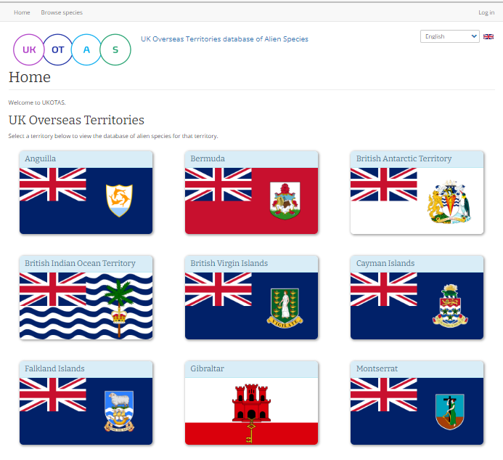
A development website

Slide 5
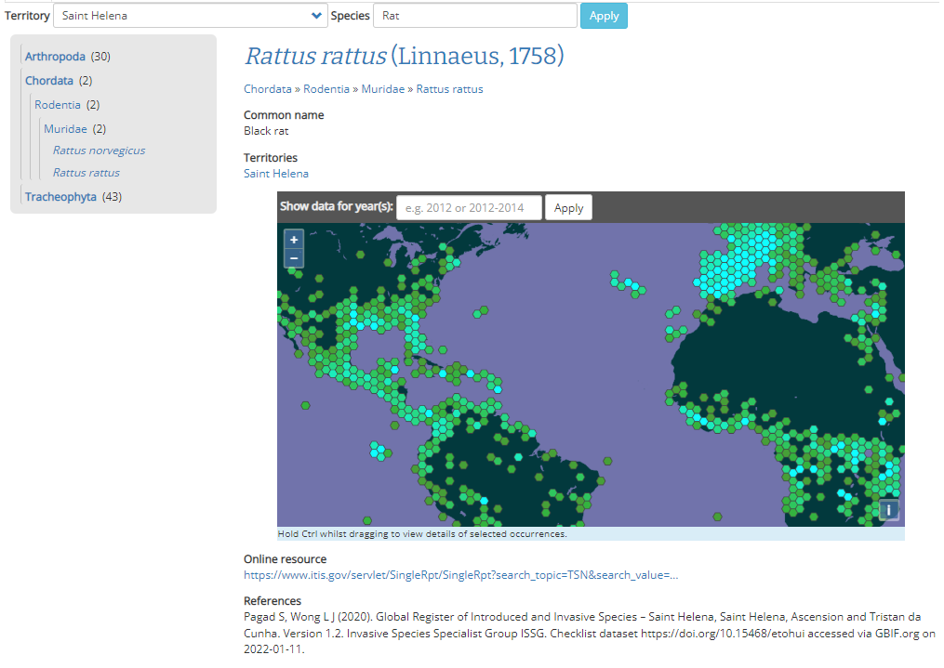
Data populated for two territories: St Helena

Slide 6
Data outputs (indicators)
Data for Anguilla taken from GRIIS

Slide 7
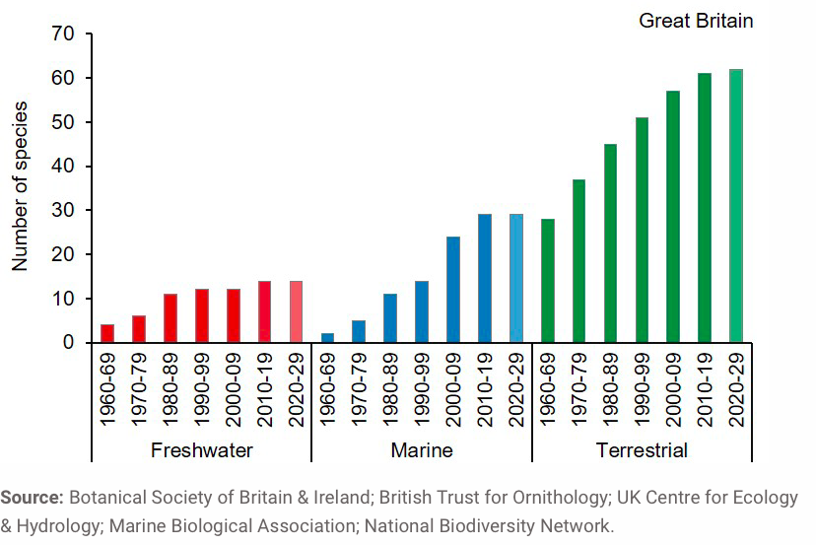
Data outputs (indicators)

Slide 8
Working with you to make it useful for your needs...

Slide 9
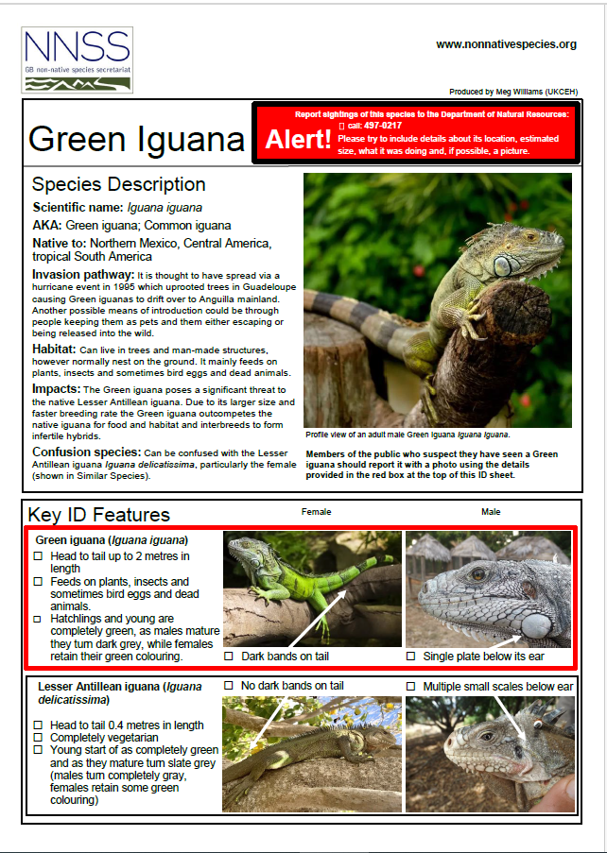
Please send any information/resources to inform database to megwil@ceh.ac.uk.

Slide 10
Breakout group questions
Check if there are any species that are missing from the dataset
Enter any missing common names
Enter where species can be located on Montserrat

Slide 11
Breakout group questions
Which columns do you think are most useful to populate in the next breakout session?
Of the priority species review compiled information e.g. has non-native species status been appropriately attributed?
Try to gap fill data in the selected columns.

