Slide 1
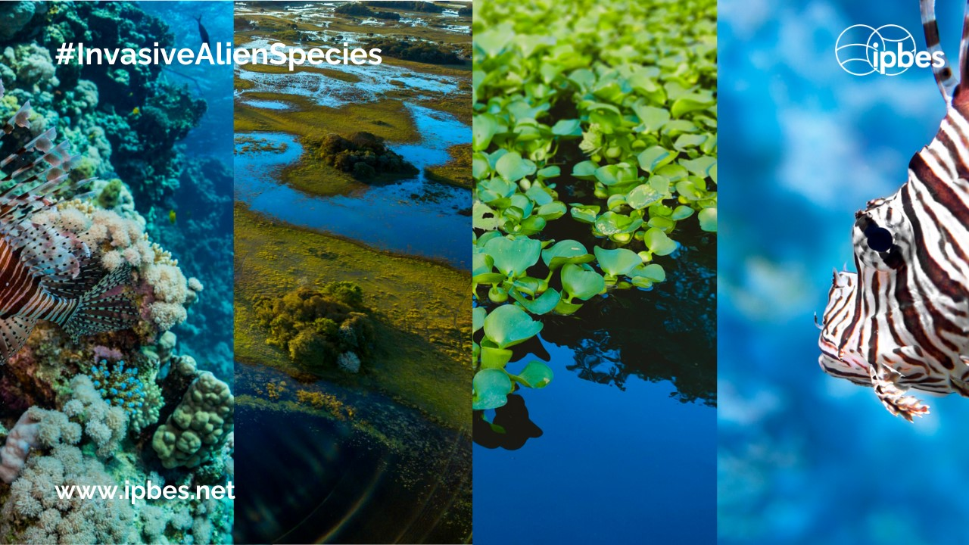
Database on Impacts of Invasive Alien Species-IPBES Chapter 4
Kelly Martinou

Slide 2
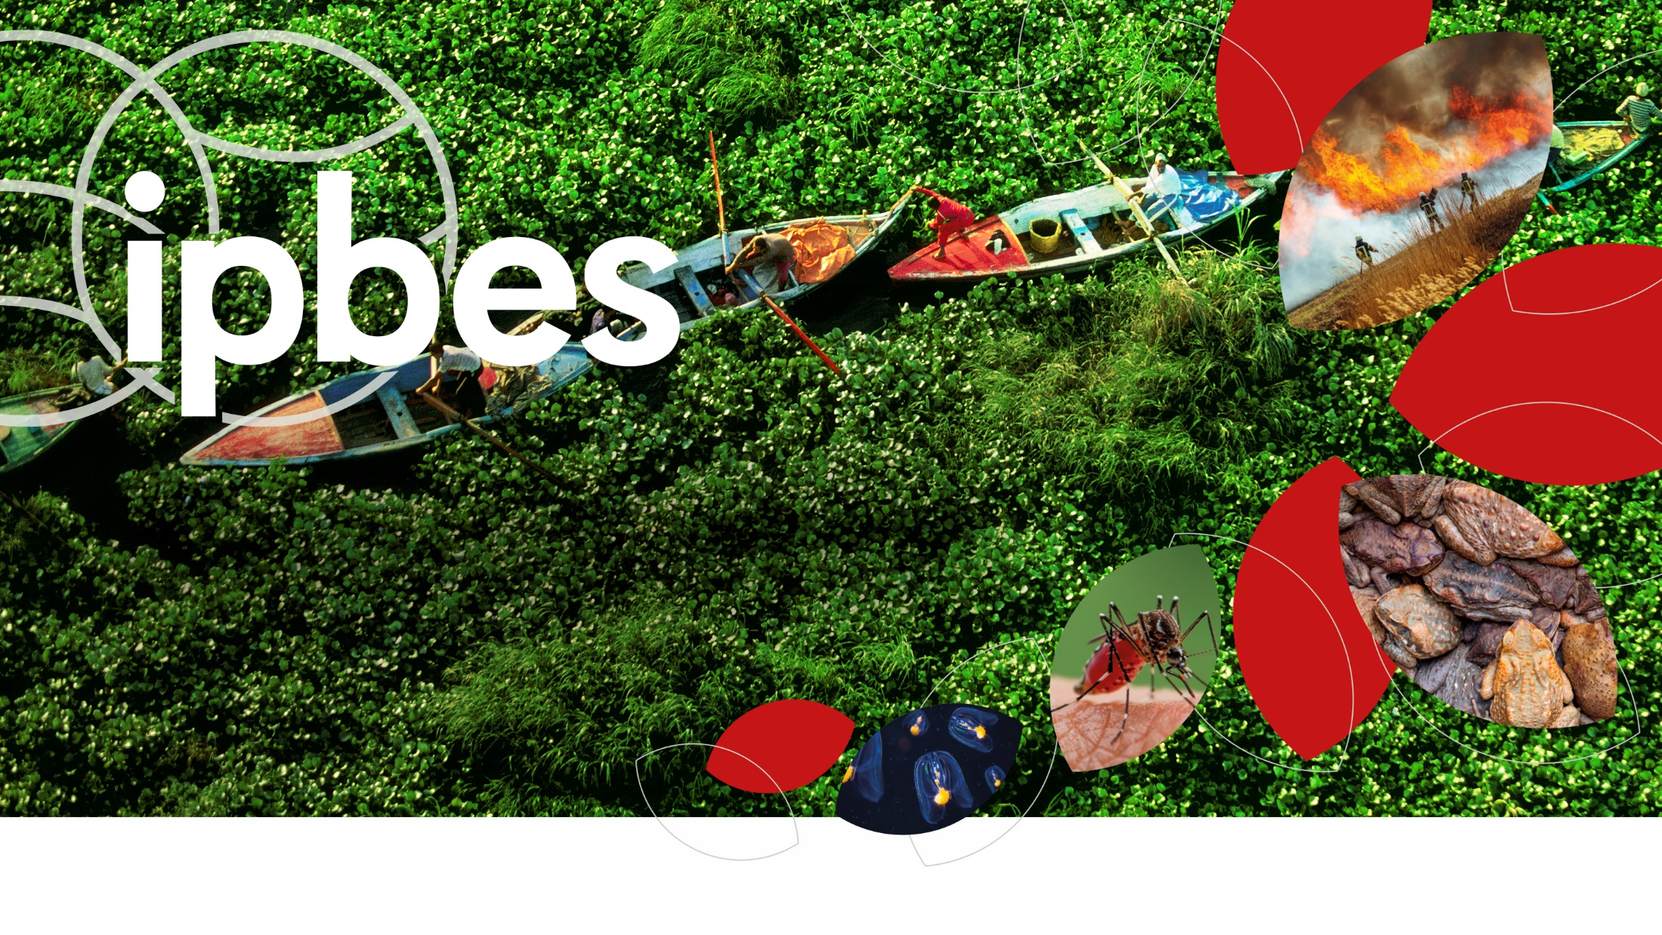
Assessment Report on Invasive
Alien Species and their Control
www.ipbes.net
The Intergovernmental Science-Policy Platform
on Biodiversity & Ecosystem Services
#InvasiveAlienSpecies Assessment

Slide 3
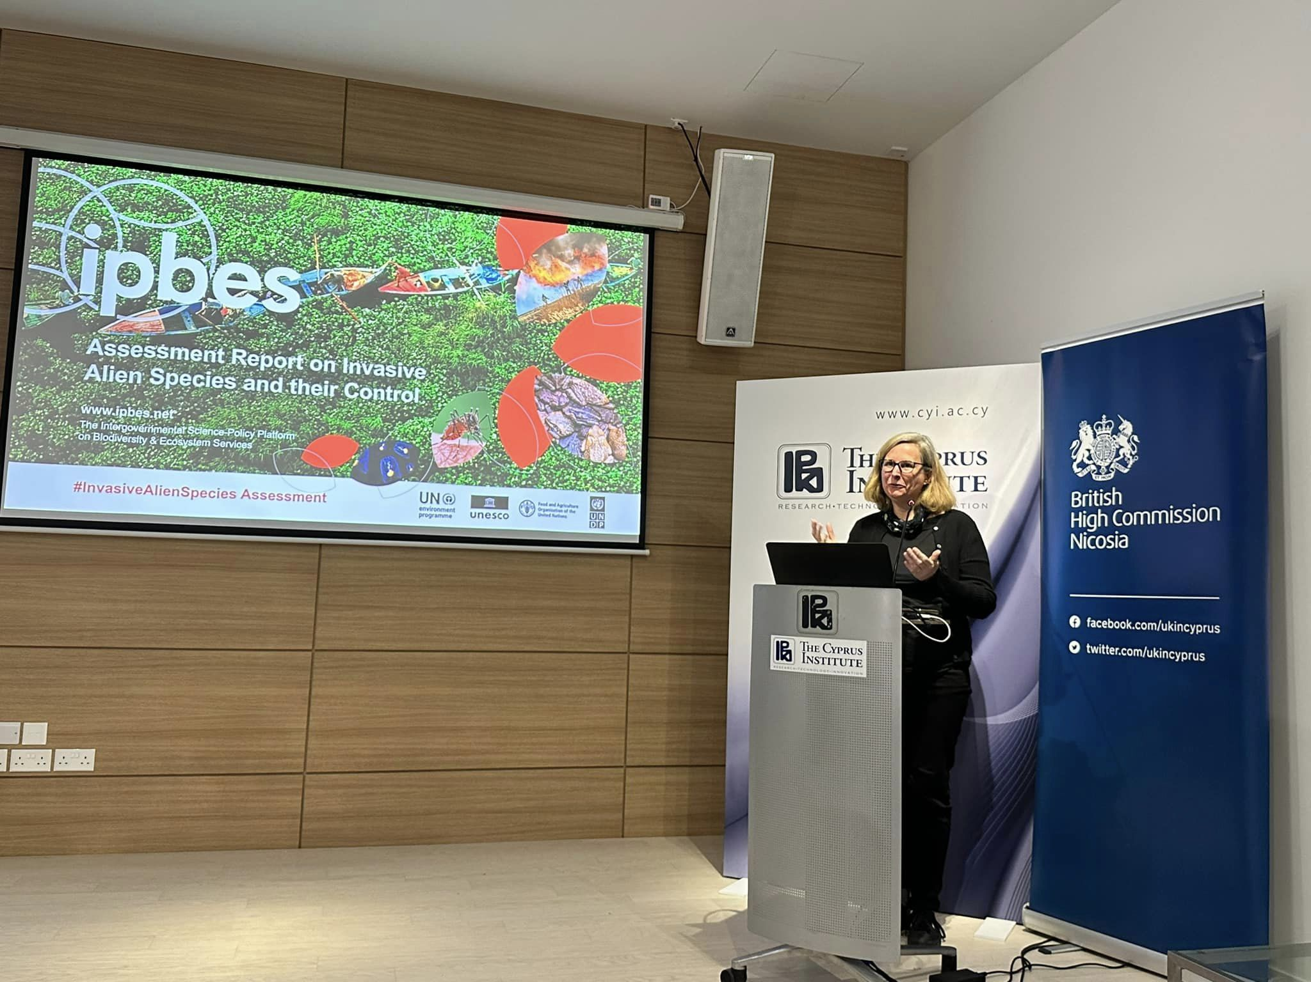

Slide 4
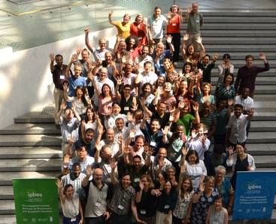
Produced by a multidisciplinary team of 86 experts and
many contributing authors
86 nominated experts from 47 countries, encompassing all regions and many disciplines
About 200 contributing authors
13000 documents reviewed
Supported by a management committee
Technical support unit based in Japan (Institute for Governance and Environmental Strategies, IGES)
#InvasiveAlienSpecies Assessment

Slide 5
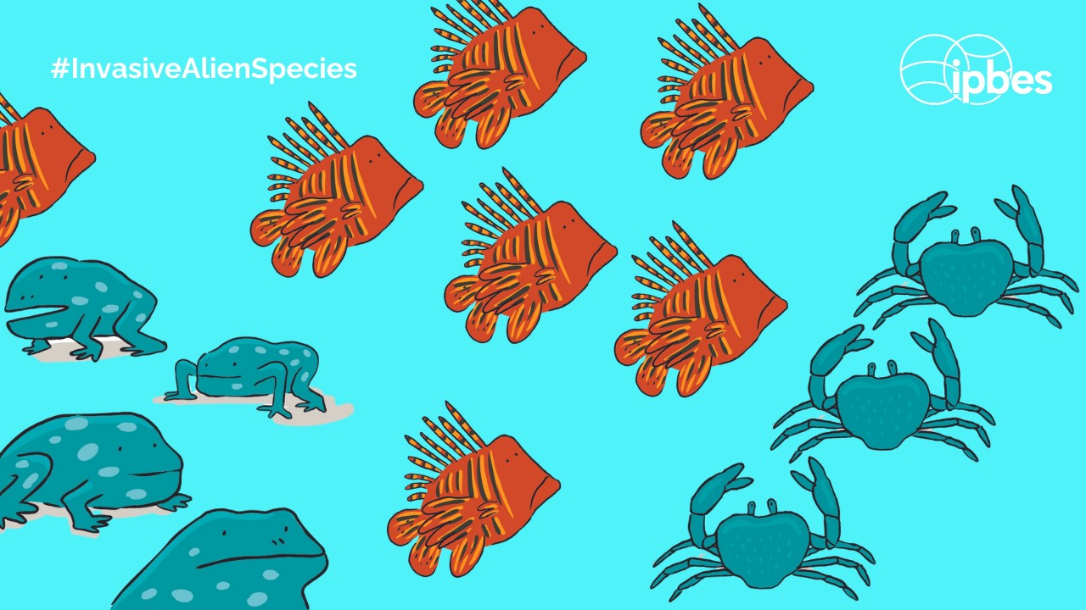
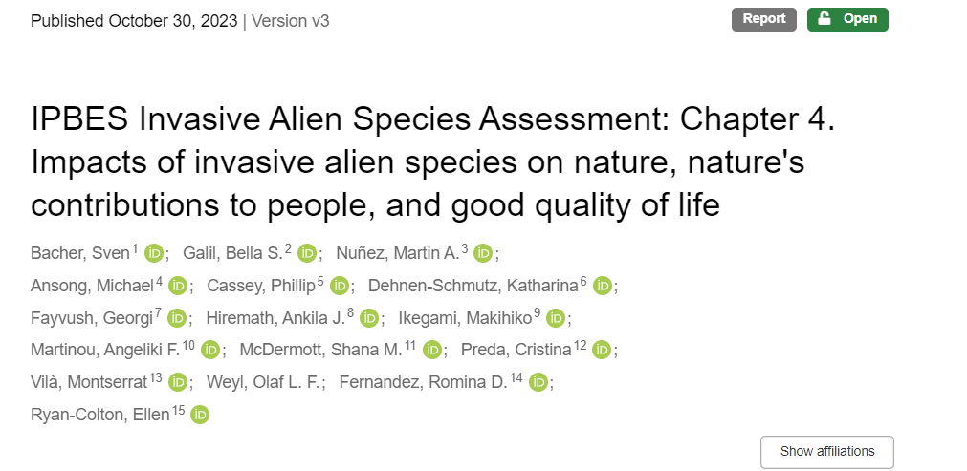

Slide 6
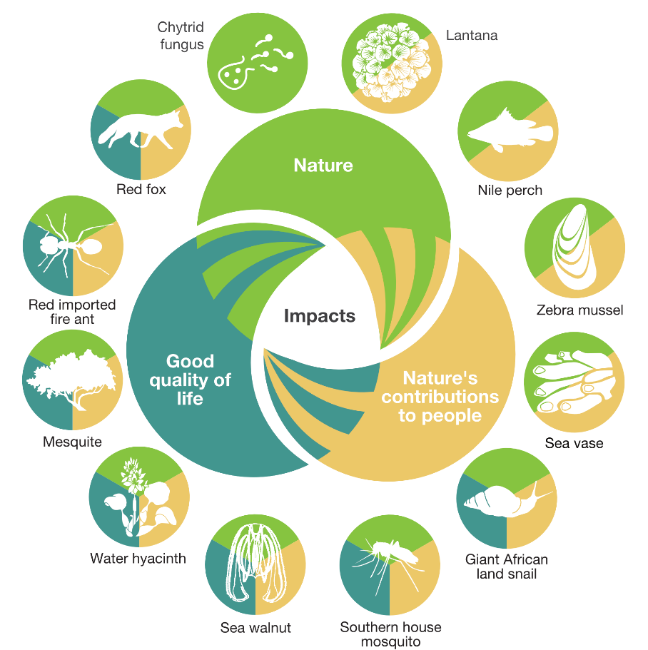
People and nature are threatened by invasive alien species in all regions of Earth
37,000 established alien species have been introduced by human activities worldwide
200 new alien species every year
3,500 invasive alien species, with negative impacts on nature, and also on people
More than 2,300 invasive alien species are found on lands of Indigenous Peoples across all regions of Earth
#InvasiveAlienSpecies Assessment

Slide 7
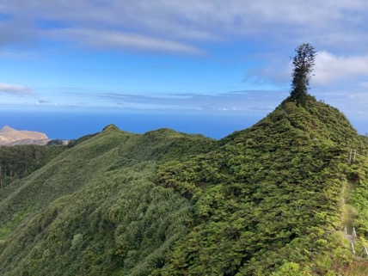
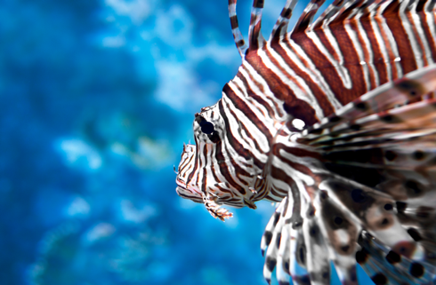
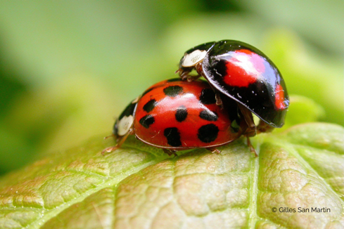
What are the mechanisms of impacts on nature?
  Change ecosystems
  27%
  Predation and herbivory
  18% and 12%
  Compete with native species
  24%
And also through hybridization, transmission of disease, parasitism, poisoning/toxicity, bio-fouling or other direct physical disturbance, chemical, physical, structural impact on ecosystem and indirect impacts through interactions with other species
#InvasiveAlienSpecies Assessment

Slide 8

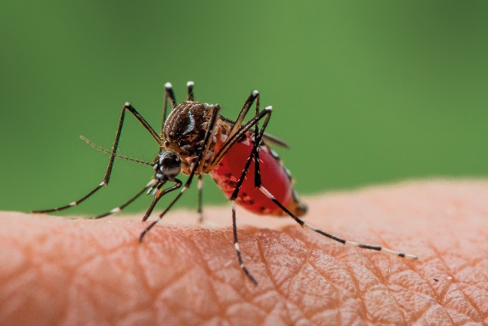
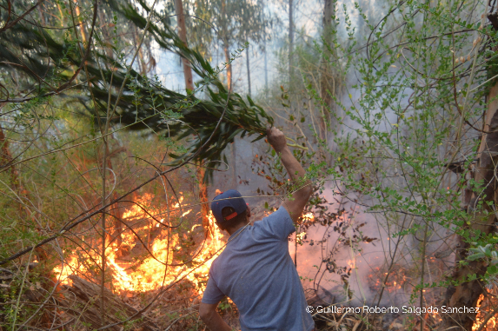
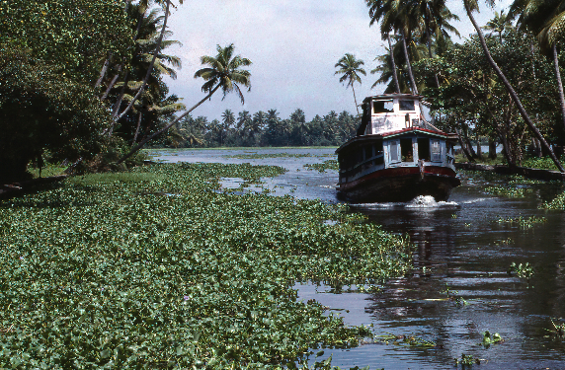
How do invasive alien species impact people?
Economies, food security, water security, human health and cultural identities are profoundly and negatively affected by invasive alien species
People with the greatest direct dependence on nature, including Indigenous Peoples and local communities, may be disproportionately affected by invasive alien species
#InvasiveAlienSpecies Assessment

Slide 9
A few numbers on impacts
60%
>$423 billion
85%
80%
is the estimated global annual costs of biological invasions in 2019
of impacts on nature and good quality of life are negative
of impacts on nature’s contributions to people are negative
of global species extinctions have been caused, solely or alongside other drivers, by invasive alien species
#InvasiveAlienSpecies Assessment

Slide 10

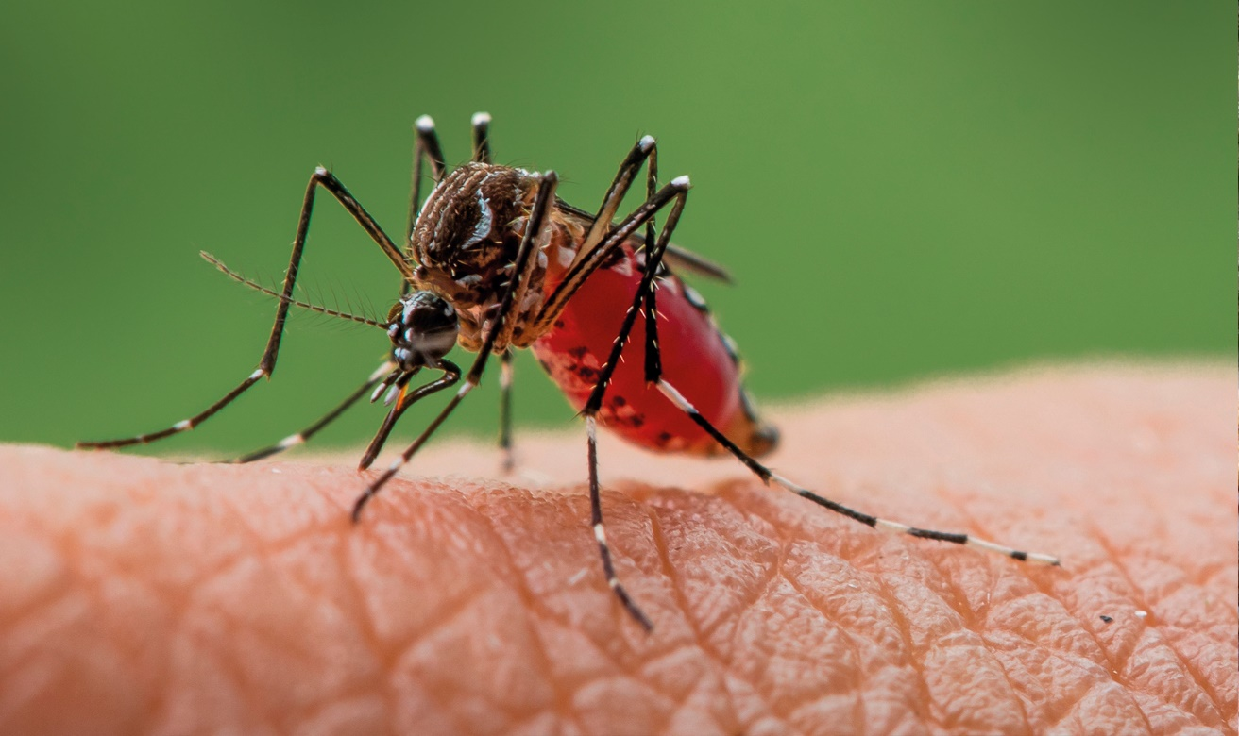
Chapter 4. Impacts of IAS Database

Slide 11
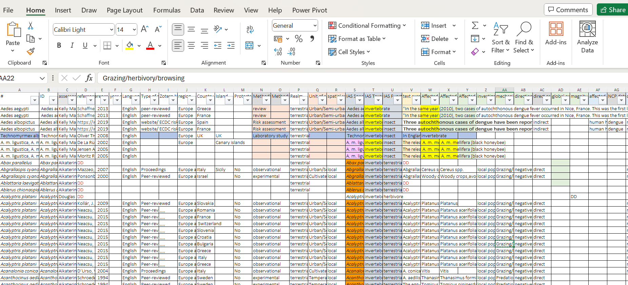

Slide 12
IPBES- Impacts of IAS Database
Systematic review of impacts on
nature, nature’s contributions to people and good quality of life at a global level for a large number of organisms and habitats.
Evident from the systematic review that some regions of the world have notably more information in scientific publications than others

Slide 13
Introduction to impacts Database
Despite vast numbers of terrestrial, inland waters, and marine introductions over millennia documentation of impacts is rare until the twentieth century.
Studies that actually document IAS impacts have been limited to 3515 IAS, about 10% of all alien species according to the Global Register of Introduced and Invasive Species (GRIIS)

Slide 14
Methodology of impacts database
The geographical location of the impact.
The corresponding IPBES unit of analysis
Recording whether the impacted area was on an island or in a protected area.
The name of the invasive alien species, and the name (where possible) and taxonomic group (plant, invertebrate, vertebrate, and microbe) of native species affected, as described in the document,
If the species was intensively used for multiple purposes by humans.
Source of information

Slide 15
Methodology of impacts database
The mechanism, magnitude (only for negative impacts) and direction of impacts on nature at the local population level
The mechanism and direction of impacts on nature’s contributions to people
The direction, magnitude (only for negative impacts) of impacts and affected constituents of good quality of life
The relation to Indigenous and local knowledge.
Authors did not collect data on the synergistic effects of climate change and other drivers of change

Slide 16
Content of Impacts database
Data on 24,129 reports of impacts
Caused by 3,515 invasive alien species
Representing 10.9 per cent of all alien species taxonomic groups
No studies of impacts for many alien species
The real percentages of invasive alien species causing impacts is likely to be higher than documented in Chapter 4
All numbers in Chapter 4 are based on this single database compiled specifically for Chapter 4

Slide 17
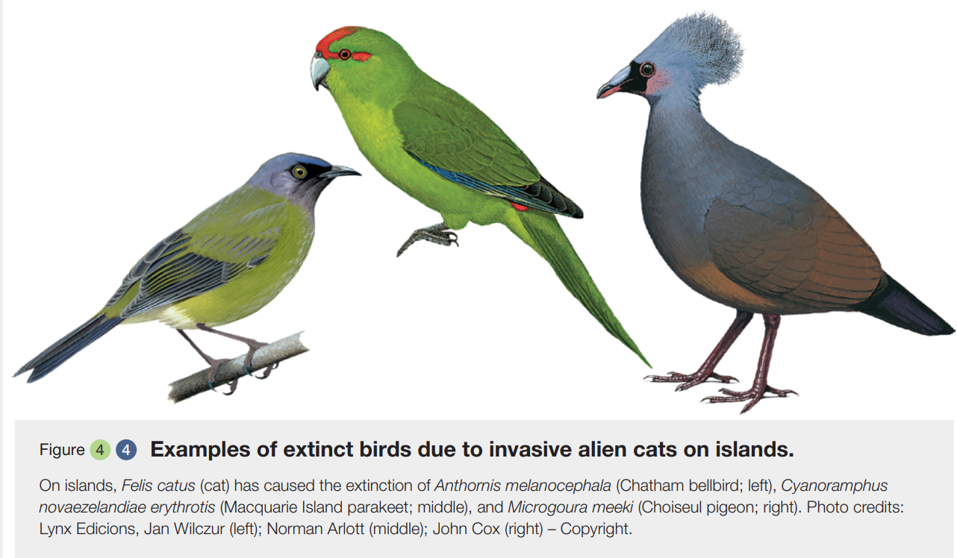
Some illustrations from Chapter 4

Slide 18
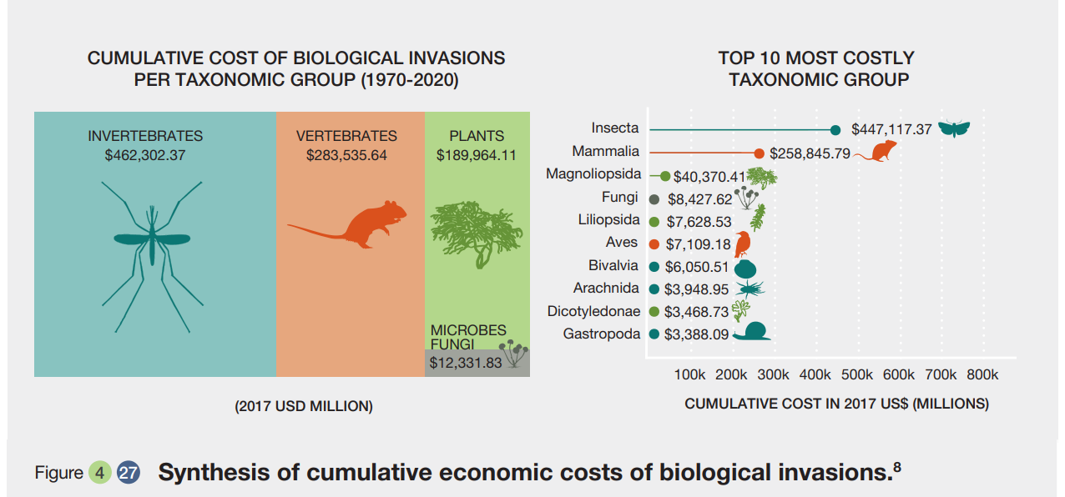

Slide 19
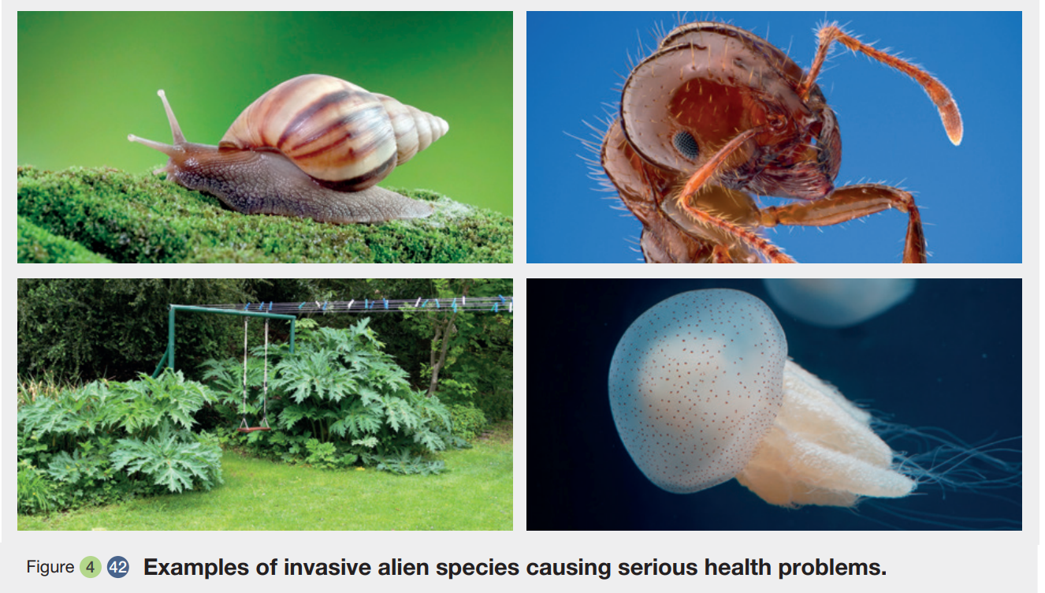

Slide 20
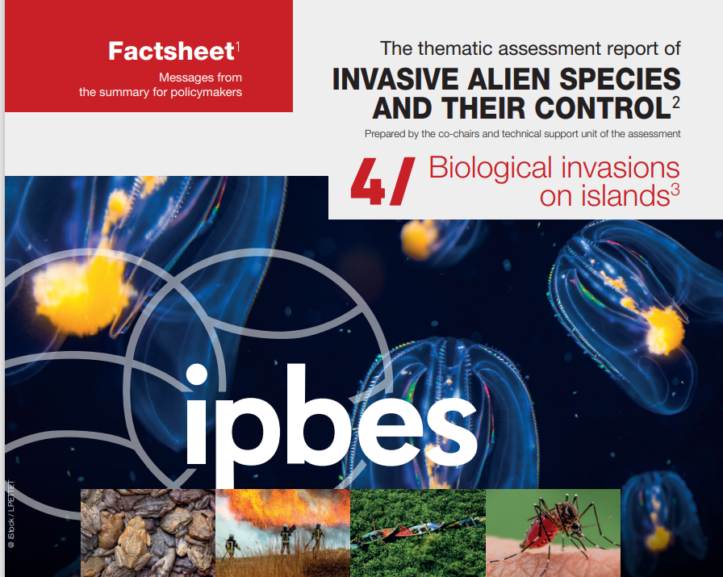
Roy, H. E., Pauchard, A., Stoett, P., & Renard Truong, T. (2023). IPBES Invasive Alien Species Assessment: Factsheet 4 - Biological invasions on islands. Zenodo. https://doi.org/10.5281/zenodo.10057032

Slide 21
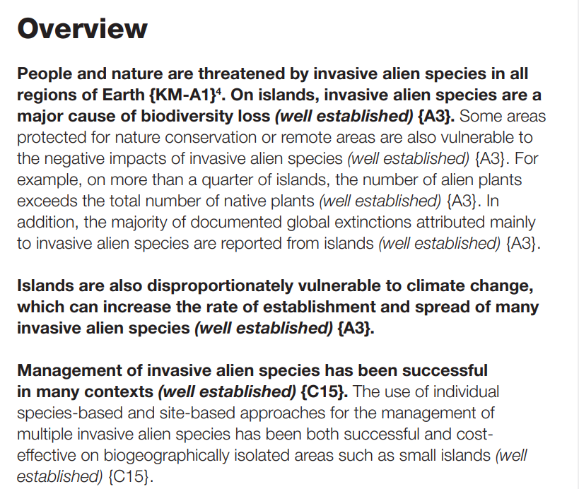

Slide 22
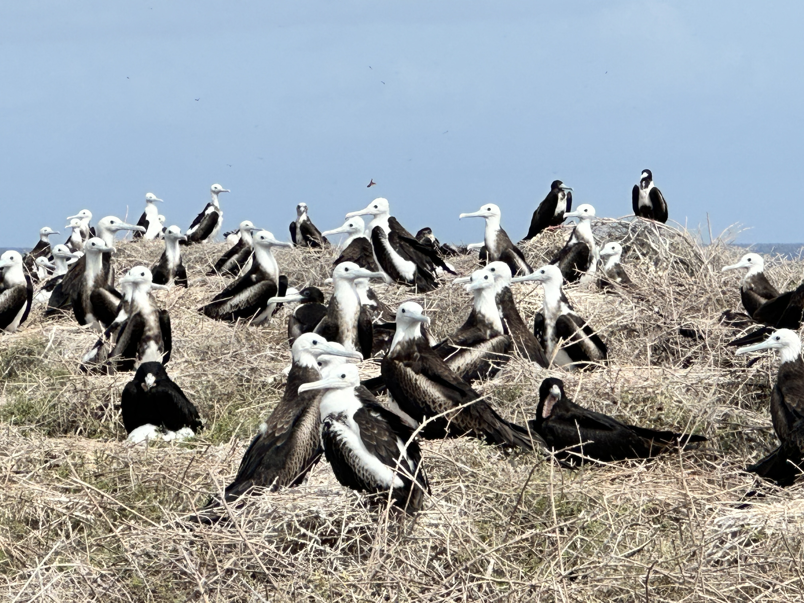
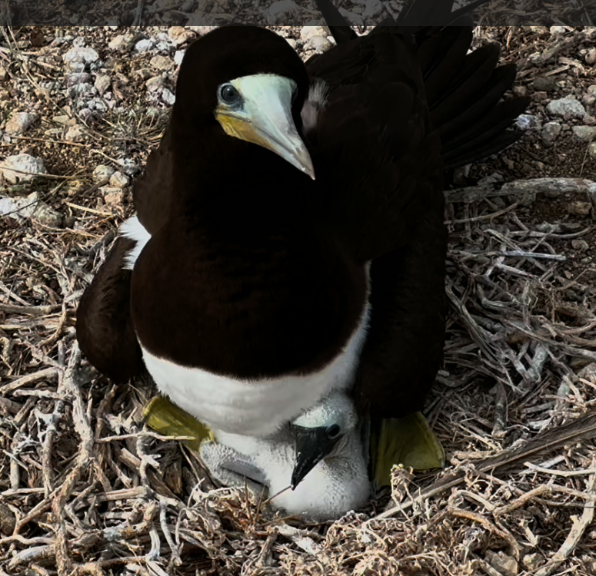

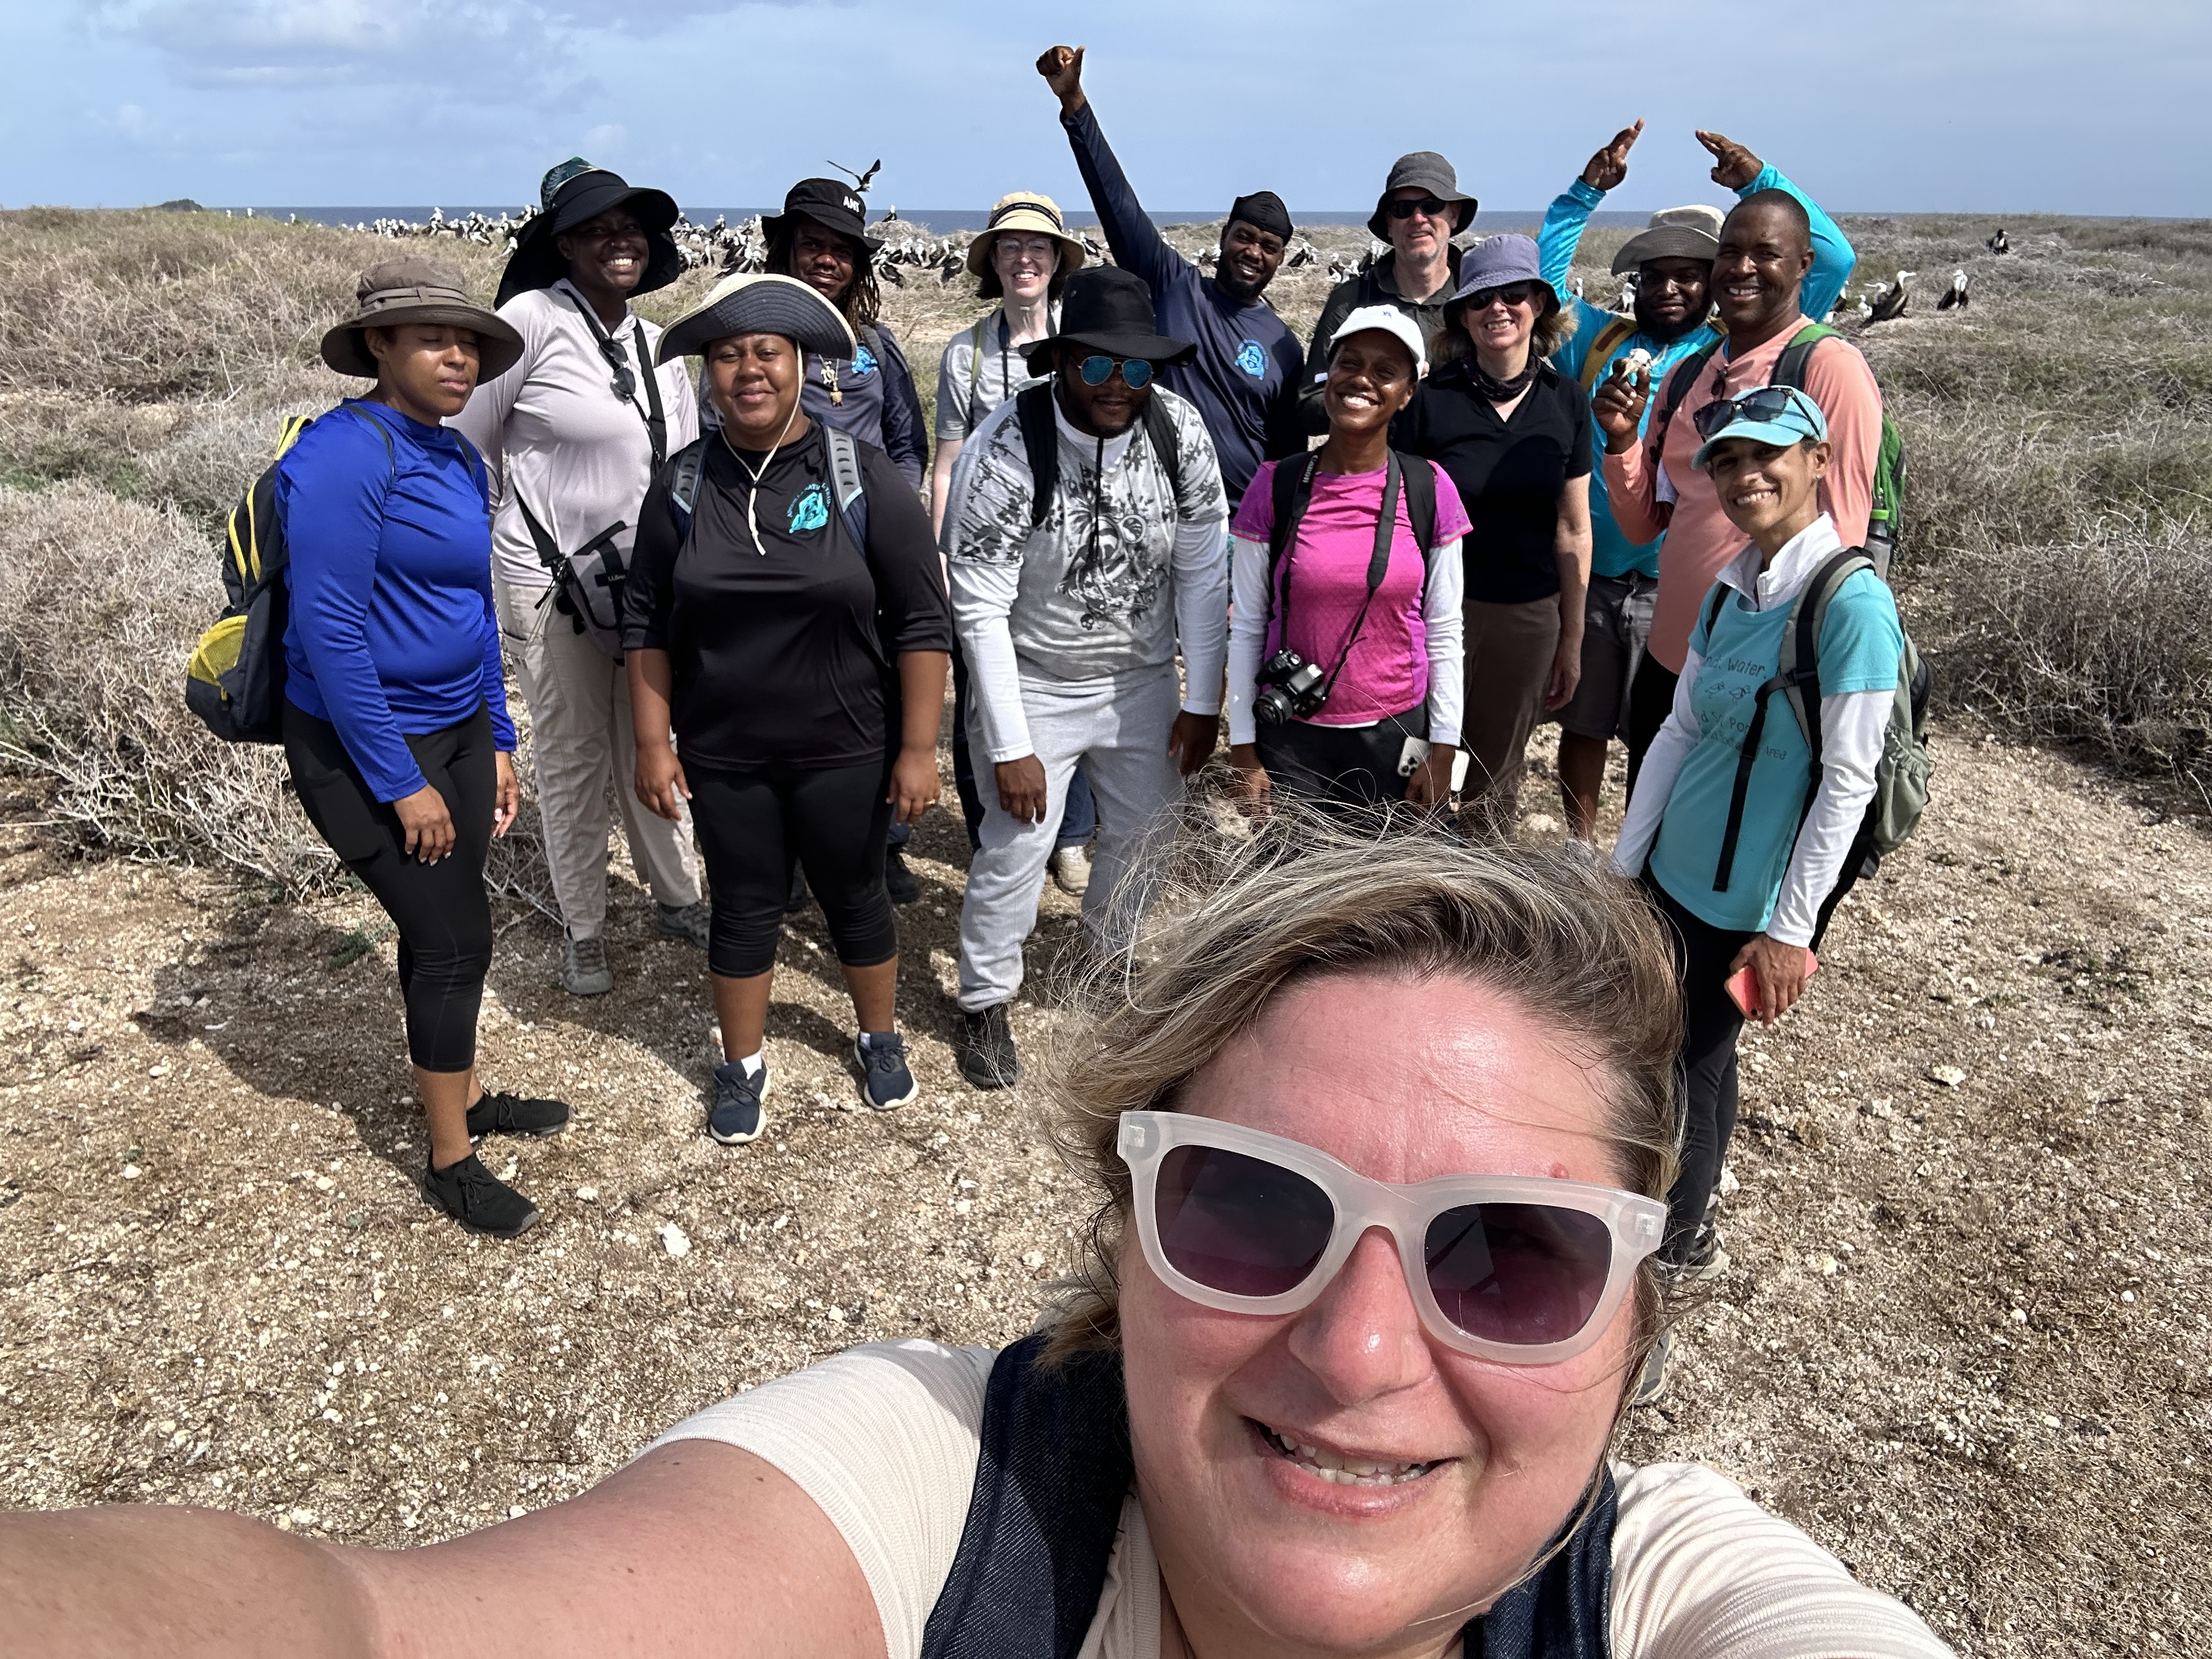
Dog Island- Anguilla, Caribbean
Successful Rat Eradication programme

Slide 23
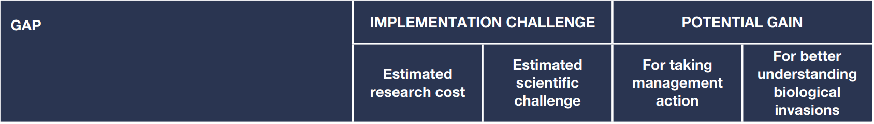
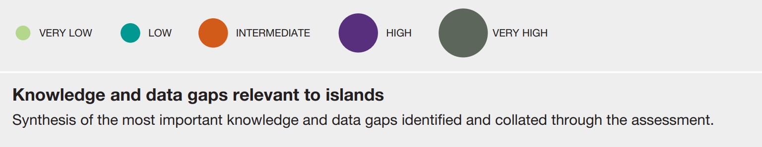

Slide 24
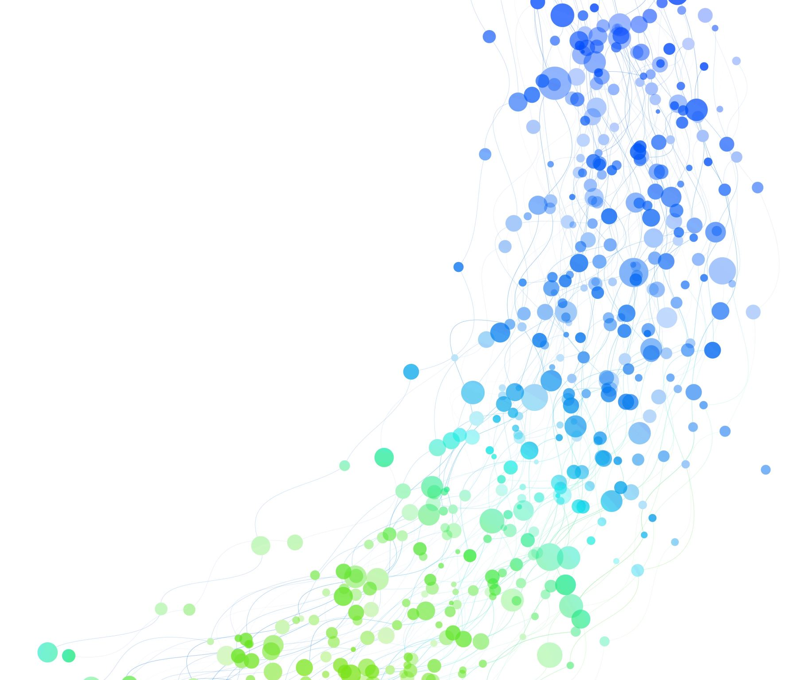
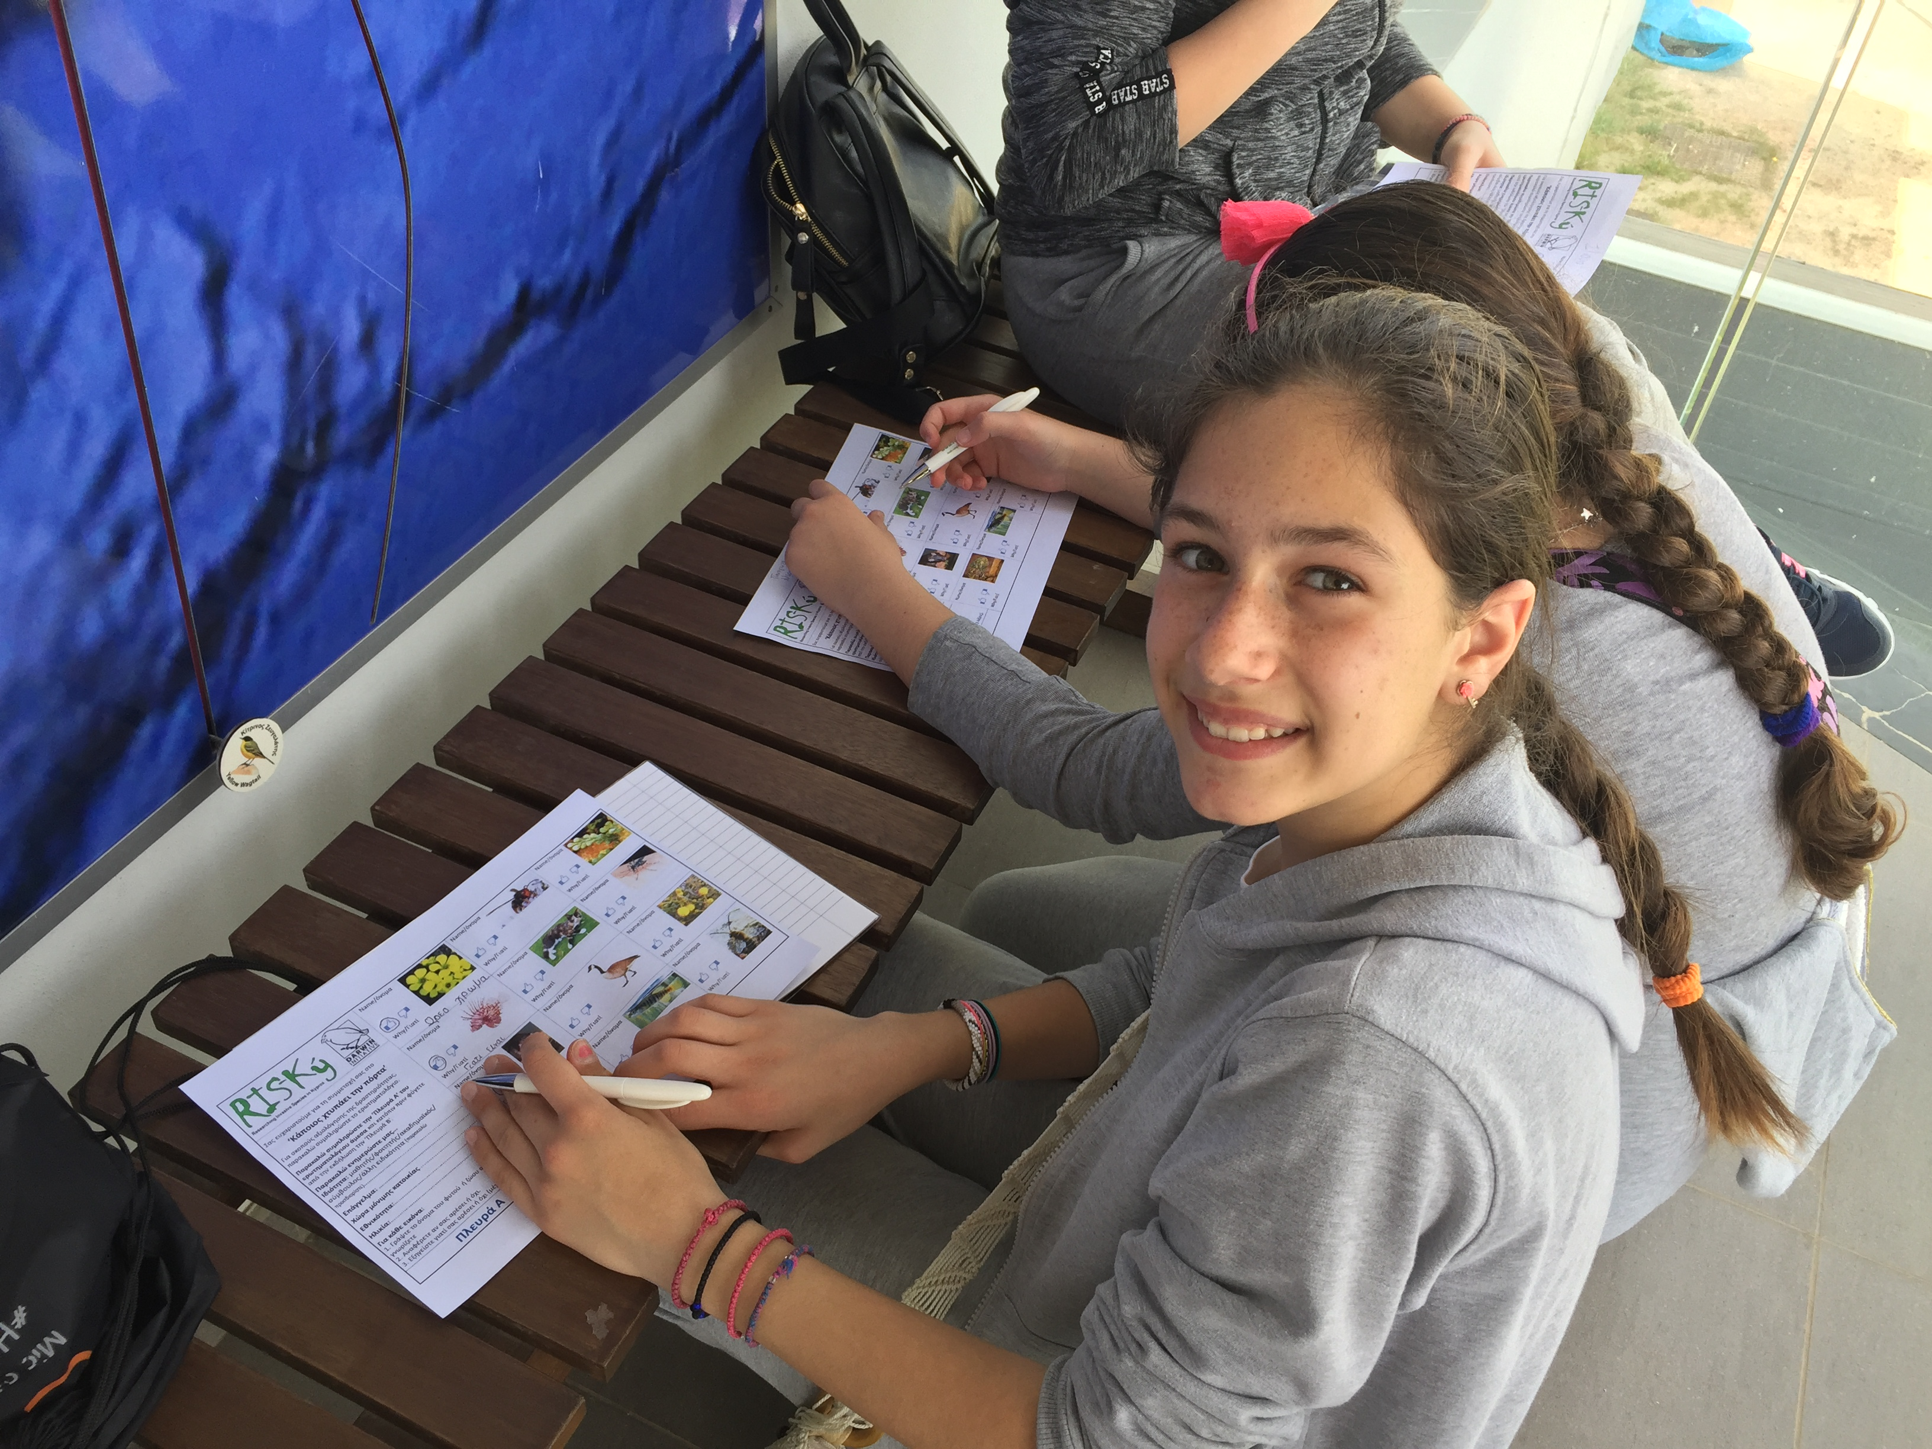
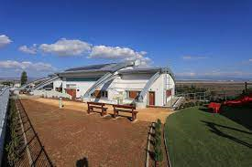



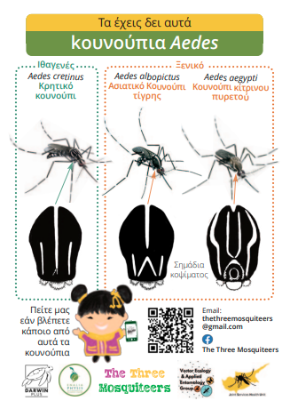

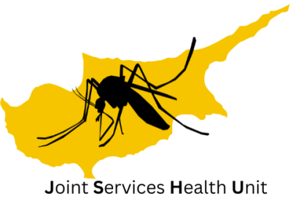
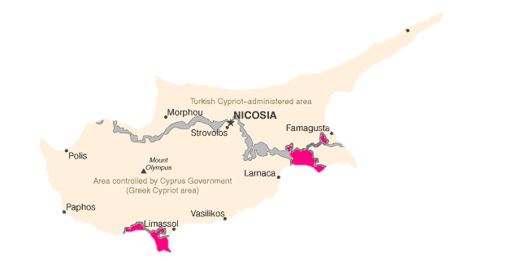
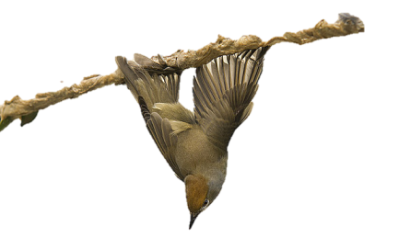
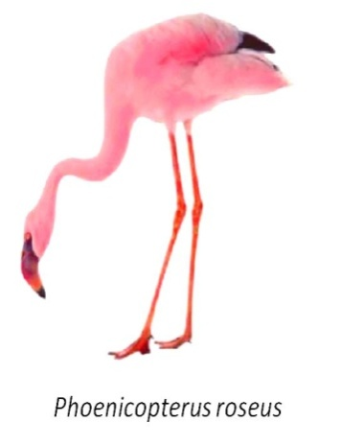
Raising awareness about mosquitoes
https://www.youtube.com/@martinoulab
https://martinoulab.weebly.com/
Notes:
Joint Services is an environmental health unit of British Forces Cyprus and we are responsible for issues concerning human health around the British camps of Akrotiri, Episkopi and Dhekeleia. I am based at the headquarters which are in Akrotiri. We are in total about 80 members of staff military and civilian personnel

